Slide 1
Concurrency and Parallelism
GameConnection Europe 2017
Jason Gregory Lead Programmer, Naughty Dog Inc.

Slide 2
Overview
Today’s computer hardware is increasingly parallel
Need to understand concurrency to take advantage of parallelism
Need to understand the hardware and the kernel to understand concurrent programming!
In this talk we’ll cover:
modern parallel computing hardware,
concurrent programming techniques, and
how to apply this to building a high-performance game engine

Slide 3
What is Concurrency?
What is concurrency?
What is parallelism?
How are they related? How do they differ?
Discussion: 5 mins

Slide 4
What is Concurrency?
Concurrency can be defined as the transformation of a shared data file
Shared by multiple flows of control
processes,
threads,
fibers…
Multiple readers and/or writers
… of shared data!
Did I mention the data has to be shared?

Slide 5
What is Concurrency?
Data “file” can be anything
A global Boolean variable shared between threads
A shared queue
Data file can live anywhere
Virtual memory space within a multithreaded process
Multiple processes sharing virtual memory pages within a single computer
GPU and CPU(s) sharing physical RAM
e.g., PS4, Xbox One
A pipe between two processes (cat foo.txt | grep "bar")
A file living on a network drive that’s accessible by multiple computers

Slide 6
What is Concurrency?
If data isn’t being shared, it isn’t concurrency
It’s just computing “at the same time”
Data A
Data B
Not
concurrency!
transform
transform
Data A'
Data B'

Slide 7
What is Concurrency?
Multiple Readers = Concurrency
Data A
transform 0
transform 1
Data A'
Data A''

Slide 8
What is Concurrency?
Data A
Data B
transform 0
transform 1
Data C
Multiple Writers = Concurrency

Slide 9
Multiple Writers = Concurrency
Transform 0
Transform 1
Shared Data
Transform 2
Transform 3
Multiple Readers = Concurrency

Slide 10
Concurrency versus Parallelism
Concurrency means multiple flows of control operating on shared data
Parallelism is multiple hardware components operating simultaneously
Concurrency is possible even on a single-core CPU
e.g., preemptive multitasking
Likewise, parallel hardware can improve performance of even single-threaded code
implict parallelism (pipelined or superscalar CPU architectures)

Slide 11
The advent of Parallelism and concurrency

Slide 12
The Advent of Parallelism and Concurrency
1970s
Intel 8087 FP coprocessor: 50 kFLOPS (5.0 × 10⁴)
Cray-1 supercomputer: 160 MFLOPS (1.6 × 10⁸)
Today
AMD Jaguar x86-64 8-core: 100 GFLOPS (1.0 × 10¹¹)
China’s Sunway TaihuLight: 93 PFLOPS (9.3 × 10¹⁶)
7 to 8 orders of magnitude improvement!

Slide 13
The Advent of Parallelism and Concurrency
In 1965, Intel co-founder Gordon Moore noticed:
computing power, measured in transistors per unit area of silicon, had been roughly doubling every year since the invention of the digital computer
Moore’s “Law” states that:
At a given price point…
amount of computing power doubles roughly every 18 months
Reality is a bit more complex...

Slide 14
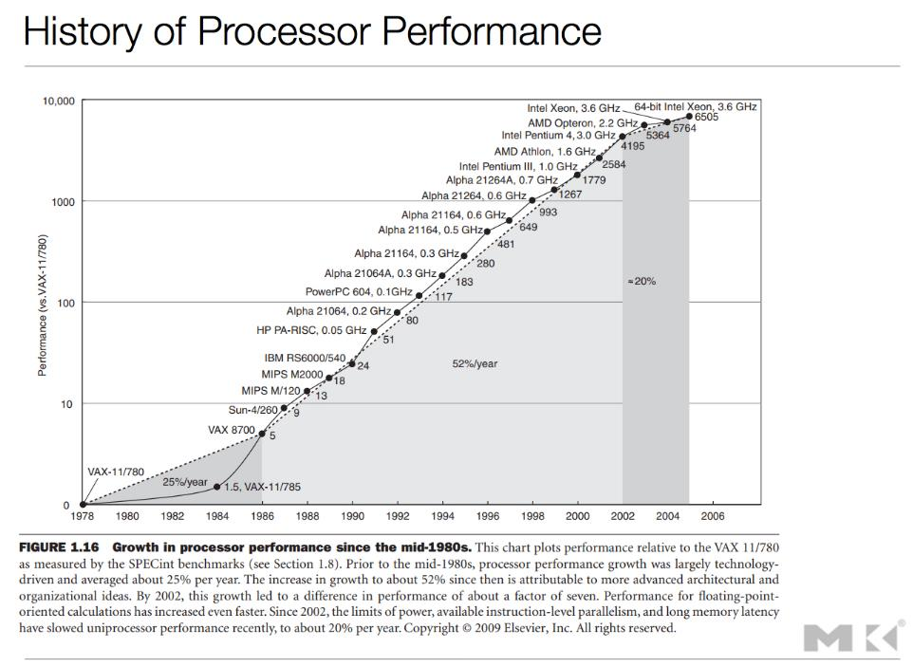
Source: https://booksite.elsevier.com/9780123838728/figures/PDF/Chapter_01.pdf
20% / year
25% / year
52% / year

Slide 15
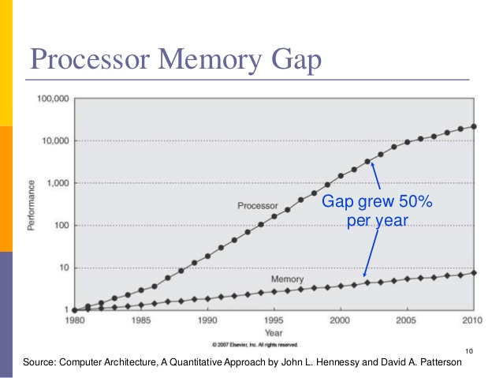

Slide 16
The Advent of Parallelism and Concurrency
Increases in clock speed led to:
increased heat generation
increased power consumption
decreased signal-to-noise ratio
Increase in memory gap led to:
Less bang for buck when improving single CPU core
Increases in transistor count led to question:
How best to use all those transistors?

Slide 17
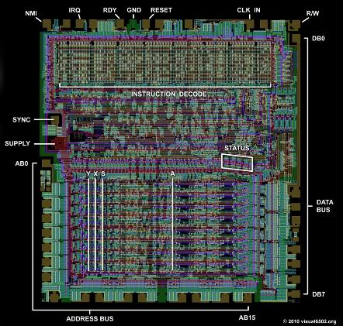
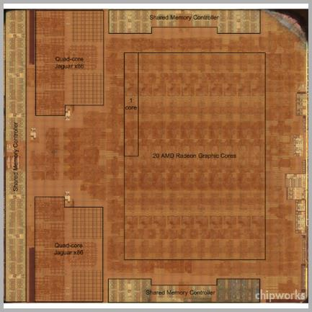
The Advent of Parallelism and Concurrency
Result: Increased use of parallelism in consumer electronics
Single-core CMOS Tech 6502 (Apple II)
8-core AMD Jaguar + Radeon HD 7870 GPU (PS4)
Quad-core Jaguar x86
20 AMD Radeon GPU Cores
Quad-core Jaguar x86

Slide 18
The Advent of Parallelism and Concurrency
Principles of parallelism known and in use since the 1960s
But back then, parallelism was reserved for high-end supercomputers
1964: Seymour Cray pioneered pipelining with CDC 6600
1972: CDC 8600 pioneered multiprocessor design by strapping four CDC 7600s together, executing in lock step
1975: Cray-1 pioneered vector processing (SIMD)

Slide 19
Implicit Parallelism
Implicit parallelism is the use of parallelism to improve performance of preexisting (sequential) code
Little or no programmer/compiler intervention required
although knowledge of implicit parallelism aids optimization!
Used in consumer electronics since ~1989
Pipelining
Superscalar
VLIW
e.g., pipelined CPU can run existing code faster than a non-pipelined CPU that supports the same ISA

Slide 20
Explicit Parallelism
Explicit parallelism exposes the presence of parallel computing hardware to the:
programmer and/or
compiler
Used in consumer electronics since ~2002
Multiprocessor computers
Multicore CPUs
SIMD vector processing unit in x86 (SSE)
Manycore GPUs (SIMT)
Explicit parallelism supports concurrency

Slide 21
Technology- Driven
Architecture- Driven - Memory gap begins to dominate - Implicit parallelism
Shift to Multicore/ Manycore
- Explicit parallelism

Slide 22
Computer Hardware Fundamentals

Slide 23
A Simple Computer
Simplest von Neumann architecture
Control Unit (CU)
Arithmetic/Logic Unit (ALU)
Registers
Memory Management Unit (MMU)
Main Memory (ROM, RAM)
CPU
CU
Main Memory (RAM, ROM)
Registers
address bus data bus
MMU
ALU

Slide 24
Machine Language
ALU and MMU instructed to do useful things by a program encoded as an instruction stream
Each instruction performs one simple(ish) operation
Move data between registers and memory
Perform arithmetic (add, sub, mul, div, …)
Perform logical ops (bit shift, and, or, ...)
Typically inputs and outputs are registers
Branch (i.e., change contents of instruction pointer, IP)
Conditional (based on bits in status register)
Unconditional (jump)

Slide 25
Machine Language
Each ML instruction comprised of:
Opcode: which operation to perform
Addressing mode flags: how to perform the operation
Operands: on what data should CPU operate
An ML instruction is encoded into an instruction word
Can be fixed-width or variable width
Opcode
AM
Operand 0
Operand 1
Opcode
AM
Operand 0
Operand 1
Opcode
AM
Operand 0
Opcode
AM
Operand 0
Operand 1
Extended Opcode
AM
Operand 0
Operand 1
Opcode
AM
Operand 0
Operand 1

Slide 26
Assembly Language
Hard to remember numeric opcodes, modifier flags and how to properly encode operands into instruction words!
Assembly language uses textual programming language to encode ML program
Mnemonics for opcodes
mov = move data between memory and registers
mul = multiply
jmp = jump; bz = branch if zero
Use register names
Can label branch targets and global variables

Slide 27
Assembly Language
AddIfGreater: ; function prologue push ebp ; push base ptr (EBP) onto stack mov ebp, esp ; set EBP to cur stack top (ESP) push ebx ; also save EBX because we use it ; load arguments a and b into registers EAX and EBX mov eax, dword ptr [ebp+8] mov ebx, dword ptr [ebp+12] ; if (a > b) cmp eax, ebx ; compare the values jle ReturnZero ; jump if less than or equal ; return a + b; add eax, ebx ; add & store result in EAX jmp Done ; (EAX is the return value) ReturnZero: ; else return 0; xor eax, eax ; set EAX to zero (return value) Done: ; function epilogue: restore registers and return pop ebx pop ebp ret

Slide 28
Instruction Set Architecture (ISA)
Each CPU provides a different instruction set architecture (ISA)
ISA defines:
Set of opcodes recognized by CPU
Number and names of registers
Addressing modes supported by CPU
Exposes some details about the hardware
Does the CPU contain an FPU? a VPU?
How is I/O done? Memory-mapped? Register-based?
Can it issue multiple instructions per clock? (VLIW)
Privileged mode supported? How many protection rings?

Slide 29
Execution Context
Input Data Stream
Instruction Stream
r1,r2
Thread =
Running instance of an instruction stream
Single flow of control
Execution context =
Instruction stream (IP)
Contents of all registers
Call stack
CPU core =
Hardware components needed to execute a thread
mul r1,r2
r3,r4
add r3,r4
...
...
CPU Core
Output Data Stream
r0
r5
...

Slide 30
Execution Context
Main Memory
CPU
Instruction Stream
Registers
mul r1,r2
CU
IP
add r3,r4
Status
BP
...
SP
Call Stack
f()
GPRs
g()
...
Data
ALU
MMU

Slide 31
Memory Architectures

Slide 33
Memory Cache Hierarchies
Memory access latency = the time between:
requesting data from memory controller and
that data arriving in a CPU register
Latency highly dependent on proximity to CPU core
Register latency: 1 cycle
Main RAM latency: 200+ cycles

Slide 34
Nonuniform Memory Access (NUMA)
One way to reduce memory latency is to give each CPU its own local memory bank
e.g., local stores for each SPU on PS3

Slide 35
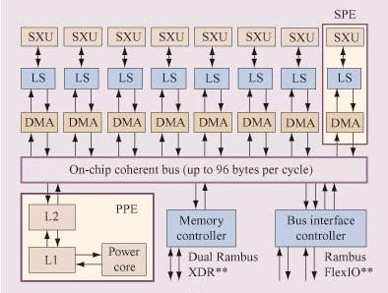
Nonuniform Memory Access (NUMA)
PS3 cell architecture

Slide 36
Nonuniform Memory Access (NUMA)
PS3’s DMA controller (DMAC) is like a little coprocessor whose only job is to ferry data around on the system buses
A form of parallelism!

Slide 37
Nonuniform Memory Access (NUMA)
Another example is the scratchpad on PS2
Scratchpad memory wasn’t actually faster to access by CPU
But it could be accessed by CPU directly, without using system address and data buses
As a result, CPU could be busy doing work with data in scratchpad while the buses and DMAC were busy transferring data

Slide 38
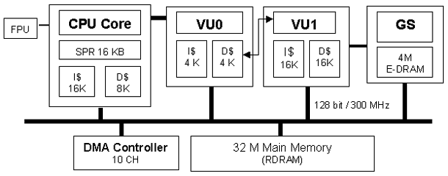
Nonuniform Memory Access (NUMA)
PS2 architecture, showing scratchpad (SPR)

Slide 39
Memory Cache Hierarchies
Local stores require explicit DMA, hard to program
Can we use this same idea, but make it “automatic”?
Keep most-recently used data in a cache that is:
Closer to CPU core (for lower latency, like local stores)
Smaller than main RAM (to keep costs in control)

Slide 40
Memory Cache Hierarchies
CPU
far far away…
CU
L1 Cache
Main RAM
Registers
Memory Controller
ALU

Slide 41
Memory Cache Hierarchies
CPU Die
not so far away…
CPU Core
far far away…
CU
L1 Cache
L2 Cache
Main RAM
Registers
Memory Controller
ALU

Slide 42
Memory Cache Hierarchies
Memory cache hierarchies reduce average memory access latency…
by taking advantage of temporal and spatial locality
Temporal locality
Data tends to be accessed repeatedly in a short time window
If a program accesses address x, there’s a good chance it’ll access address x again in the near future
Spatial locality
Data tends to be accessed sequentially, or in blocks
If program accesses address x, there’s a good chance it’ll access address x + n as well (for small |n|)

Slide 43
Memory Cache Hierarchies
Caches work by dividing main memory into lines
64- or 128-byte lines are typical

Slide 44
Memory Cache Hierarchies
Lines of main RAM can be read into the cache
Once in the cache, CPU can access the data more quickly

Slide 45
Memory Cache Hierarchies
Once a line is in the cache, how do we know from which memory line it came?
Line index
64-byte cache: (addr & 0x3F)
128-byte cache: (addr & 0x7F)
Tag
64-byte cache: (addr >> 6)
128-byte cache: (addr >> 7)
Store the tag with each cache line to keep track of its original location in memory

Slide 46
Memory Cache Hierarchies
Tags are stored with each line in cache to keep track of from whence each line came
Tags
0x1FFEFFFF
0x00002222
0x000A354
0x00001800
0x00D0D1D1

Slide 47
Memory Cache Hierarchies
When CPU reads a data item (single byte or larger):
Address converted into line index
Memory controller checks L1 cache: Does cache already contain this line?
Hit: If line is present, fetch data from the line
Miss: If not present, fetch from next level cache (L2)…
Rinse and repeat until main memory is reached
On a multicore system, read requests may also be fulfilled by other cores at the same level

Slide 48
Memory Cache Hierarchies
When CPU writes a data item (single byte or larger):
Address converted into line index
Memory controller checks L1 cache: Does cache already contain this line?
Hit: If line is present, write item into line, mark line modified
(This gets more complicated in a multicore machine…)
Miss: If not present, fetch line from L2, L3, … main memory, write and mark modified
Writes to cache lines not necessarily written back to main RAM immediately
Write-back triggered on next read or invalidate of cache line
Write-through operation can bypass cache

Slide 49
Memory Cache Hierarchies
What we’ve just described is a direct-mapped cache
Each line in memory maps to exactly one line in cache
Conflicts are likely (e.g., addresses 0x80, 0x100 and 0x180)
Fully associative cache
Any line in memory can be placed anywhere in the cache
Requires linear search of tags to find lines in the cache
n-way set associative cache
Each line in memory maps to n lines in cache
Best of both worlds:
Reduces line conflicts by factor of n
Limited searching (only search the ways, not entire cache)

Slide 50
Memory Cache Hierarchies
e.g., 2-way set associative cache
Each line in memory maps to 2 lines in cache

Slide 51
Memory Cache Hierarchies
What happens when cache becomes full?
Must evict previous data to make room
Cache line replacement policy
FIFO (first in, first out)
Only option in a direct-mapped cache
NMRU (not most-recently used): 1 bit per set
LRU (least-recently used): costly for n > 2
LFU (least-frequently used)
Pseudo-random (!)
Optimal?
https://ece752.ece.wisc.edu/lect11-cache-replacement.pdf

Slide 52
Memory Cache Hierarchies
Memory access latencies on PS4
Registers: 1 cycle
L1 cache: 4 cycles
L2 cache: 26 cycles (190 cycles between 4-core clusters)
Main RAM: 200+ cycles
L1 cache usually split into two distinct caches:
Instruction cache (I$)
Data cache (D$)
This prevents code from degrading data cache performance, and vice-versa
e.g., a big loop iterating over array of small data items

Slide 53
Memory Cache Hierarchies
So why do we care about caches?
Aren’t they “automagic”?
Can’t programmers just ignore them (trust that they work) and get on with programming?
Discussion: 5 mins

Slide 54
Memory Cache Hierarchies
So why do we care about caches?
Understanding caches is an optimization tool
Structure data to avoid excessive cache misses
Pack data into non-sparse arrays
Avoid skipping around in memory

Slide 55
Memory Cache Hierarchies
Consider a particle system in which each particle is defined like this:
class Particle
{
ParticleId m_globalId;
Point m_pos;
Quat m_rot;
Vector m_scale;
Color32 m_color;
Texture* m_apTex[4];
Vec2 m_aUV[4];
AnimConfig m_animConfig;
// ...
};
sizeof(Point) == 16
Therefore, only 4 Points per cache line, on a CPU with 64-byte lines.

Slide 56
Memory Cache Hierarchies
void ApplyWind(const Vector& windVel, Particle* aParticle, const int count) { const float dt = GetFrameDeltaTime();
const Vector windVelPerFrame = windVel * dt; for (int i = 0; i < count; ++i)
{
Particle& part = aParticle[i]; part.m_pos += windVelPerFrame; // cache miss every time!
} }
…
aParticle[0]
aParticle[1]
aParticle[2]

Slide 57
Memory Cache Hierarchies
Let’s rearrange the data to improve cache performance
class ParticleGroup
{
I32 m_count;
ParticleId* m_aGlobalId;
Point* m_aPos;
Quat* m_aRot;
Vector* m_aScale;
Color32* m_aColor;
Texture** m_apTex; // 4 per particle
Vec2* m_aUV; // 4 per particle U16* m_aAnimConfigIndex;
// ...
};

Slide 58
Memory Cache Hierarchies
void ApplyWind(const Vector& windVel, ParticleGroup& group) { const float dt = GetFrameDeltaTime();
const Vector windVelPerFrame = windVel * dt; for (int i = 0; i < group.m_count; ++i)
{
group.m_aPos[i] += windVelPerFrame;
} }
m_aGlobalId[]
m_aPos[]
…
m_aRot[]
m_aScale[]
m_aColor[]

Slide 59
Memory Cache Hierarchies
So why do we care about caches?
Understanding caches is an optimization tool
Structure code to avoid excessive cache misses too
Keep time-critical loops small in terms of code size
Inlining can be helpful, but can also lead to code bloat
Avoid virtual function calls in tight loops

Slide 60
Memory Cache Hierarchies
void UpdateParticles(Particle* aParticle, const int count) {
const float dt = GetFrameDeltaTime(); for (int i = 0; i < count; ++i)
{
Particle& part = aParticle[i];
AnimatePosition(part.m_pos, part.m_animConfig, dt);
AnimateRotation(part.m_rot , part.m_animConfig, dt);
AnimateColor(part.m_color , part.m_animConfig, dt);
ApplyGravity(part.m_pos, dt);
ApplyWind(part.m_pos, dt);
// ...
}
// If the body of this loop doesn’t fit in I$, we
// could be getting I$ misses on every iteration. }

Slide 61
Memory Cache Hierarchies
void UpdateParticles(ParticleGroup& group) {
const float dt = GetFrameDeltaTime();
// This approach could be much more I$ friendly... for (int i = 0; i < group.count; ++i)
{ const int iAnimConfig = part.m_aAnimConfigIndex[i];
AnimatePosition(part.m_aPos[i], iAnimConfig, dt); }
for (int i = 0; i < group.count; ++i)
{ const int iAnimConfig = part.m_aAnimConfigIndex[i]; AnimateRotation(part.m_aRot[i], iAnimConfig, dt);
}
// ...
}
What about D$ issues with anim config indices?

Slide 62
Memory Cache Hierarchies
So why do we care about caches? (continued)
Understanding caches is crucial for concurrency
Data intended to be “local” to a core/thread should be on its own cache line
Atomic instructions like compare-and-swap (CAS) operate on cache lines
Multiple cores share cache lines via MESI protocol
Memory barriers/fences
More on this topic later…

Slide 63
Processes, Threads and the Kernel

Slide 64
The Kernel
The kernel is the core of the OS
Provides all of the low-level features of the OS
Processes and threads
File and network I/O
Virtual memory mapping and swap file management
Scheduling threads to run on available CPU cores (preemptive multithreading)
Handles most interrupts
Interfaces to hardware drivers
Higher-level OS functionality provided by services
Themselves processes, many of which run in user mode

Slide 65
The Kernel
The kernel…
Runs in ring 0 (privileged mode) on the CPU
Works directly in terms of physical memory addresses
Large block of addresses are reserved for use by the kernel, called kernel space
e.g., under 32-bit Windows and Linux: upper 1 or 2 GiB
Handles interrupts via interrupt service routines (ISRs)
Hardware and software interrupts
User-space programs request privileged services by making system calls (aka kernel calls)
Set up arguments, then trigger a software interrupt
Causes context switch into kernel—expensive! (1000 cycles)

Slide 66
Processes
A process is a running instance of an executable file (.exe on Windows, .elf under Linux/MacOS)
Executable file contains:
Text segment: Relocatable machine code
Data segment: Initialized global and static variables
BSS segment: Uninitialized globals and statics

Slide 67
Processes
A process consists of:
Process id (PID)
Permissions (which user/group owns it, etc.)
Reference to parent process
Environment variables
Open file descriptors
Current working directory
Resources of managing inter-process synchronization and communication (pipes, semaphores, etc.)

Slide 68
Processes
A process consists of:
A virtual memory space containing:
Executable file image (text, data, BSS)
One or more execution contexts (threads), i.e. call stacks
Heap for dynamic allocation
One thread by default, but can spawn multiple threads

Slide 69
Virtual Memory
Each process has its own private “view” of memory
User-space programs perform all memory accesses in terms of virtual addresses
The CPU and kernel cooperate in order to map virtual addresses to physical addresses at runtime

Slide 70
Virtual Memory
Disk
Virtual Addresses
Physical Addresses
0xFFFFF000
0xFFFFE000
0xFFFFD000
unmapped
swap file
0xFFFF4000
...
0x0000E000
0x00002000
0x00002000
0x00001000
0x00001000
0x00000000
0x00000000

Slide 71
Processes
Process
0xFFFFFFFF
Kernel
Space
File Descriptors
Thread
Execution Context
0x80000000
Unused
Virtual Memory
Call Stack
Registers
Heap
Call Stack
Virtual Memory Map
Shared Memory
DLLs
Heap
Data
BSS
BSS
Code (text)
Data
Other Resources
Text
Unused
0x00000000

Slide 72
Threads
The kernel doesn’t actually run processes
It runs threads!
A process contains one thread by default, but can spawn more
A thread represents a single instruction stream
A thread’s execution context consists of:
A call stack (region of memory for stack frames, grows down)
Registers
IP (current instruction), SP and BP (stack frame), GPRs and status register
All threads in a process share the same virtual address space

Slide 73
Threads and Processes
Process
File Descriptors
Thread
Thread
Thread
Execution Context
Execution Context
Execution Context
Virtual Memory
Registers
Registers
Registers
Heap
Call Stack
Call Stack
Call Stack
DLLs
Data
BSS
Code (text)
Other Resources

Slide 74
Thread API
Each OS/kernel provides its own API for creating threads
IEEE POSIX 1003.1c threads (pthreads) is a standard API available on all UNIX favors and also Windows
Windows has a native API too, of course
PS4 SDK’s thread API is modeled after pthreads
C++11 added threading to the standard library

Slide 75
Thread API (POSIX)
#include <pthread.h>
void entry_point(int i) { ... }
int main()
{
pthread_t t1, t2;
pthread_create(&t1, nullptr, entry_point, 0);
pthread_create(&t2, nullptr, entry_point, 1); // do some other useful work while threads run...
pthread_join(&t1);
pthread_join(&t1); // at this point, both threads have terminated
}

Slide 76
Thread API (C++11)
#include <thread>
void entry_point(int i) { ... }
int main()
{
std::thread t1(entry_point, 0);
std::thread t2(entry_point, 1); // do some other useful work while threads run...
t1.join();
t2.join();
// at this point, both threads have terminated
}

Slide 77
Thread API (Windows)
#include <windows.h>
DWORD WINAPI entry_point(LPVOID lpParam) { ... }
int main()
{ HANDLE ahT[2];
ahT[0] = CreateThread(NULL, 0, entry_point, …);
ahT[1] = CreateThread(NULL, 0, entry_point, …);
// do some other useful work while threads run...
WaitForMultipleObjects(2, ahT);
// at this point, both threads have terminated
}

Slide 78
Thread Scheduling
Basic thread state machine*
Runnable
Thread is able to run, but is waiting to be assigned a time slice on a core
Running
Thread is actively running on a core
Sleeping/Blocked/Waiting
Thread is waiting for an event, timer, mutex lock, etc.
In this case, we say the thread is blocked
*Real operating systems have a few more states

Slide 79
Thread Scheduling
A few examples of blocking calls
usleep() puts the thread to sleep for specified number of microseconds
read() puts the thread to sleep until the requested data has been read by the file system
A thread can also be put to sleep while waiting for a mutex lock (more on this later!)
Sleeping threads are woken up by kernel when the resource becomes available or timer expires

Slide 80
Thread Scheduling
Runnable Threads
Blocked Threads
Thread 4
Thread 4
Thread 1
Thread 6
Thread 0
End of Quantum
Wake
Thread 8
Thread 3
Thread 7
Running Threads
Sleep/Block
Thread 2
Thread 5
Schedule
Core 0
Core 1
CU
L1 I$
CU
L1 I$
F/D
L1 D$
F/D
L1 D$
Execution Context
ALU, FPU
Execution Context
ALU, FPU

Slide 81
Thread Scheduling
When a thread transitions from Running to
Runnable or
Blocked
... and another thread is scheduled on a core, we call this a context switch
Context switches also happen when a thread makes a kernel call
Context switch involves saving the registers of the outgoing thread; restoring registers of incoming thread

Slide 82
0xFFFFFFFF
Thread Context Switch
(Thread 0 Running)
Kernel
Space
0x80000000
Unused
CPU Core
Call Stack (Thread 0)
Execution Context (Registers)
Virtual Addresses
Call Stack (Thread 1)
Registers (Thread 0)
SP
Shared Memory
Heap
copy
BSS
Kernel RAM
Data
Registers (Thread 0)
Text
Registers (Thread 1)
Unused
0x00000000

Slide 83
0xFFFFFFFF
Thread Context Switch
(Thread 1 Running)
Kernel
Space
0x80000000
Unused
CPU Core
Call Stack (Thread 0)
Execution Context (Registers)
Virtual Addresses
Call Stack (Thread 1)
Registers (Thread 1)
SP
Shared Memory
Heap
BSS
Kernel RAM
copy
Data
Registers (Thread 0)
Text
Registers (Thread 1)
Unused
0x00000000

Slide 84
0xFFFFFFFF
Process Context Switch
(Process A Running)
Kernel
Space
0x80000000
CPU Core
Unused
Execution Context (Registers)
Call Stack (Thread 0, Proc A)
Registers (Thread 0, Process A)
Shared Memory A
SP
Virtual Addresses
Active Page Table
Virtual Page Table (Process A)
Heap A
BSS A
Kernel RAM
Data A
Virtual Page Table (Process A)
Registers (Thread 0, Process A)
Text A
Virtual Page Table (Process B)
Registers (Thread 0, Process B)
Unused
0x00000000

Slide 85
0xFFFFFFFF
Process Context Switch
(Process B Running)
Kernel
Space
0x80000000
CPU Core
Unused
Execution Context (Registers)
Call Stack (Thread 0, Proc B)
Registers (Thread 0, Process B)
SP
Virtual Addresses
Shared Memory B
Heap B
Active Page Table
Virtual Page Table (Process B)
copy
copy
BSS B
Kernel RAM
Data B
Virtual Page Table (Process A)
Registers (Thread 0, Process A)
Text B
Virtual Page Table (Process B)
Registers (Thread 0, Process B)
Unused
0x00000000

Slide 86
Thread Scheduling
Threads can be assigned priorities
Used to select threads from the Runnable state for time slices on available CPU core(s)
Higher-priority threads given preference
Can lead to starvation of lower-priority threads
Process’s nice value can also affect the effective priorities of its threads

Slide 87
Thread Scheduling
Case study: Linux thread scheduling
Threads can be given a scope
PTHREAD_SCOPE_PROCESS versus PTHREAD_SCOPE_SYSTEM
Each SYSTEM thread gets equal share of CPU time
Each group of threads within a single process at PROCESS scope gets a share of CPU equal to one SYSTEM thread
Priorities work like this:
When a thread is runnable, and no other thread within the process has a higher priority, it will be scheduled
Threads with equal priority round-robin across available cores
Starvation of lower-priority threads unless all higher-priority threads block

Slide 88
Thread Scheduling
https://www.microsoftpressstore.com/articles/article.aspx?p=2233328&seqNum=7
Case study: Windows thread scheduling
Threads can have one of 32 priorities
Separate queue for each priority
Highest-priority runnable thread always runs, with caveat…
… threads can be assigned processor affinity
Each thread receives a time quantum, defined by various factors (system config, foreground/background process)
A thread may not complete its quantum, if a higher-priority thread becomes runnable during the quantum
Unlike Linux, every thread is given equal weight
No consideration of to which process each thread belongs

Slide 89
Implicit Parallelism

Slide 90
Pipelining
Early CPUs executed serially
One instruction at a time
Components within CPU not well separated
Many components idle while an instruction executed
Modern CPUs are pipelined
Each instruction passes through clearly-defined stages, each corresponding to a component within CPU core
Clear separation between components
Can keep all components busy by allowing multiple instructions to be “in flight” simultaneously
Each using a different component within the core

Slide 91
Pipelining
Different CPUs define their stages differently
From four to five stages…
… to up to 30+ stages in deeply pipelined CPUs
Basic stages:
Fetch an instruction word from memory (F)
Decode instruction into opcode and operands (D)
Register access (R)
We’ll assume D and R are combined (D/R)
Execute instruction on ALU (E)
Memory read/write (M)
Register writeback, i.e., store results in registers (W)

Slide 92

Pipelining

Slide 93
Pipelining
To keep each stage busy, issue a new instruction every clock
Clock Cycle
F
D/R
E
M
W
0
A
1
A
2
A
3
A
4
B
A
5
B

Slide 94
Pipelining
To keep each stage busy, issue a new instruction every clock
Clock Cycle
F
D/R
E
M
W
0
A
1
B
A
2
C
B
A
3
D
C
B
A
4
E
D
C
B
A

Slide 95
Pipelining
Pipelining is a form of instruction-level parallelism (ILP)
Measuring performance
Throughput: Number of instructions retired per unit time
Latency: Length of time required to retire a single instruction

Slide 96
Pipelining
Latency: T_{instr} (ns)
F
D/R
E
M
W
0
A
1
B
A
2
C
B
A
3
D
C
B
A
4
E
D
C
B
A
Throughput:
R = 1/T_{stage} (instr/s)
T_{stage} (ns)

Slide 97
Pipelining
A stall is defined as a situation in which not all stages are kept busy
What kinds of situations might cause stalls?
Discussion: 5 mins

Slide 98
Pipelining
A stall is defined as a situation in which not all stages are kept busy
In other words, the next instruction cannot be issued due to some kind of dependency
Three kinds of dependencies in CPU pipeline:
Data dependency: A register used in one instruction is used again in the next instruction
Branch dependency: An instruction’s operation is dependent on the results of the previous instruction (e.g. BZ)
Resource dependency: Certain types of instructions can only execute on certain hardware (e.g. integer ALU)

Slide 99
Pipelining
Dependencies are a property of an instruction stream
Dependencies can result in hazards: Impacts on the CPU pipeline (stalls)
Data dependency → data hazard: Results of a previous instruction are needed in order to issue this instruction
Branch dependency → control hazard: Need to predict branches before result of conditional expression is known
Resource dependency → structural hazard: Would like to issue, e.g., an integer add, but the ALU is busy

Slide 100
Data Hazards
Clock Cycle
F
D/R
E
M
W
int madd(int a, int b, int c) { int temp = a * b; int result = temp + c; return result; }
mul r1, r2, r3 ; r1 = r2 * r3
add r5, r1, r4 ; r5 = r1 + r4
0
mul
1
mul
2
mul
3
Bubble/stall!
mul
4
mul
5
add

Slide 101
Data Hazards
Solution to data hazard problem:
Find something for the CPU to do during the bubble!
Delay slots are the instruction slots during which the CPU is idle waiting for the current instruction to complete
Options:
Programmer can manually reorder statements in code
Compiler (optimizer) can reorder instructions automatically, based on analysis of program logic
CPU can reorder instructions on the fly
Called out-of-order execution (OOO execution)

Slide 102
Data Hazards
OOO execution allows the CPU to
reorder instructions A, B, C and D
(taken from before the add) so that
they come between the add and the
mul instructions
Clock Cycle
F
D/R
E
M
W
0
mul
1
A
mul
mul r1, r2, r3 ; r1 = r2 * r3
instrA r5
instrB r6, r7
instrC r0, r8
instrD r9
add r5, r1, r4 ; r5 = r1 + r4
2
B
A
mul
3
C
B
A
mul
4
D
C
B
A
mul
5
add
D
C
B
A

Slide 103
Data Hazards
http://cseweb.ucsd.edu/classes/wi05/cse240a/pipe2.pdf
Data dependencies come in three flavors
Read after write (RAW)
Write after write (WAW)
Write after read (WAR)
Can’t happen in vanilla pipeline
mul r1,r2,r3
add r5,r1,r4
F
D
E
M
W
F
D
E
M
W
add r1,r2,r3
sub r1,r2,r4
F
D
E
M1
M2
M3
W
F
D
E
M
W
mul r2,r1,r3
sub r1,r5,r4
F
D
E
M
W
F
D
E
M
W

Slide 104
Data Hazards
Exercise: Identify the RAW, WAW and WAR dependencies in the following instruction sequence
mul r1,r2,r3
add r5,r1,r4
mov 0x1E800,r5
mov r6,0x1E750
mov r6,(r6+4*r0)
mul r1,r2,r0
mov r2,#42
add r1,r1,r2

Slide 105
Data Hazards
Solution:
mul r1,r2,r3
add r5,r1,r4
mov 0x1E800,r5
mov r6,0x1E750
mov r6,(r6+4*r0)
mul r1,r2,r0
mov r2,#42
add r1,r1,r2
RAW
RAW
WAW, RAW
WAR

Slide 106
Data Hazards
Exercise: Reorder the instruction sequence to minimize stalls
mul r1,r2,r3
add r5,r1,r4
mov 0x1E800,r5
mov r6,0x1E750
mov r6,(r6+4*r0)
mul r1,r2,r0
mov r2,#42
add r1,r1,r2

Slide 107
Data Hazards
One possible solution…
noticing that there are really two independent sequences
so interleave them
mul r1,r2,r3
add r5,r1,r4
mov 0x1E800,r5
mov r6,0x1E750
mov r6,(r6+4*r0)
mul r1,r2,r0
mov r2,#42
add r1,r1,r2
mul r1,r2,r3
mov r6,0x1E750
add r5,r1,r4
mul r1,r2,r0
mov 0x1E800,r5
mov r2,#42
mov r6,(r6+4*r0)
add r1,r1,r2

Slide 108
Register Renaming
Register reuse within a sequence of instructions can introduce false dependencies (WAW, WAR)
One solution: register renaming
Register names used by program (“virtual” registers) are mapped to real hardware registers by CPU or compiler
before register renaming…
after register renaming…
add r3,r4,r5
ld r7,(r3)
sub r3,r12,r11
st (r15),r3
add hw3,hw4,hw5
ld hw7,(hw3)
sub hw20,hw12,hw11
st (hw15),hw20
false dependency! (WAR)

Slide 109
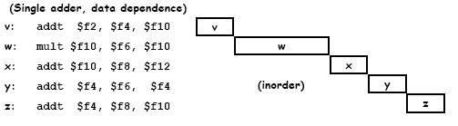
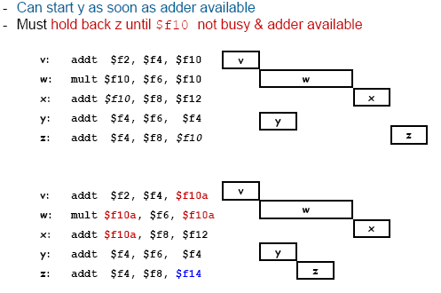
Register Renaming
http://www.math.nsysu.edu.tw/~lam/MPI/lecture/SUPERSCALAR_ARCHITECTURE.ppt

Slide 110
Memory Latency Hiding
Note that stalls can also occur due to memory latency
mov r3,[r1+8]
Might take 4, 40 or 400 cycles! (L1, L2, main RAM)
OOO execution can also help to hide memory latency
While waiting for memory controller to respond, execute other independent instructions in delay slots
Multithreading is another way to hide memory latency
While one thread is waiting for memory, other thread(s) can be scheduled to use the CPU core

Slide 111
Control Hazards
What should the CPU do when a conditional branch instruction is encountered?
Result of the condition not yet known at time of issue
Pipeline can be 10+ stages deep
Conditional branch therefore introduces 10+ cycle stall
This is called a branch penalty
Control hazard
It’s a special case of a RAW data hazard

Slide 112
Control Hazards
Clock Cycle
test
dependency
F
D/R
E
M
W
bz
0
test
add
1
test
mov
2
test
mul
3
wait for result of test
test
sub
4
test
add
5
bz

Slide 113
Control Hazards
Solutions to branch penalty problem:
Software:
Loop unrolling to increase run length (fewer if tests)
Rearrange code to minimize “branchiness”
Hardware:
Delay slots
Choose instructions to run during the stall (OOO execution)
Choose one of the two branches and execute speculatively
If the guess is correct, no stall! ☺
If the guess is wrong, flush the pipeline, back out intermediate results, and start again on the correct branch

Slide 114
Speculative Execution
How should the CPU guess?
Simple idea: Just assume…
backwards branches are always taken,
forward branches are never taken
Very common pattern in for loops
for (i = 0; i < count; ++i) { // do work... if (special_case) break; // forward branch (rare) } // backward branch (common)
Notes:
Or assume conditional branches are never taken… or always taken

Slide 115
Speculative Execution
Another idea: Rely on manual tagging of if statements
for (i = 0; i < count; ++i) { // do work... if (UNLIKELY(special_case)) break; } // gcc definitions: #define LIKELY(x) __builtin_expect((x),1)
#define UNLIKELY(x) __builtin_expect((x),0)
Notes:
NOTE: These directives simply cause the compiler to rearrange the loop so that the natural “backwards branches are likely, forwards branches are unlikely” will have the desired effect. The CPU isn’t involved.

Slide 116
Speculative Execution
Another idea: Include branch prediction logic on the CPU die
Keeps a history of which branches were taken
Logic can get quite complex
Some CPUs can detect patterns like Y, N, Y, N, Y, N, …
Increases transistor count and circuit complexity significantly
Speculative execution requires results of calculations to be stored temporarily in

Slide 117
Predication
Yet another idea:
Don’t branch at all!
Instead, always execute both sides of the branch
But mark each instruction with the condition (predicate) with which it is associated
CPU only actually commits results of predicated instructions when the condition (predicate) is true
This approach is called predication
Simpler form: partial predication
Conditional move, conditional select instructions

Slide 118
Partial Predication
Conditional select
e.g., PowerPC fsel and isel instructions
isel RR, RA, RB, predicate_code
If predicate bit is 1, move RA→RR
If predicate bit is 0, move RB→RR
cmpwi %cr7,%r11,42
beq cr7,Label1 ; if r11 == 42
li %r0,0 ; else r0 = 0
b Label2
Label1:
li %r0,1 ; set r0 = 1
Label2:
li %r1,0
li %r2,1
cmpwi %cr7,%r11,42
isel %r0,%r2,%r1,30
30 means “check
the EQ status bit
of %cr7”

Slide 119
Full Predication
test
bz
test
Z=true
add
add
Z=true
mov
mov
Z=true
mul
mul
Z=false
sub
sub
add
Z=false
add

Slide 120
Superscalar
If pipelining improves throughput, can we improve it further by adding more parallelism?
Yes: If CPU has two of each functional unit, it can issue two instructions per clock
This is called superscalar CPU architecture

Slide 121
Superscalar
Clock Cycle
F₀
F₁
D₀
D₁
E₀
E₁
M₀
M₁
W₀
W₁
0
A
B
1
C
D
A
B
2
E
F
C
D
A
B
3
G
H
E
F
C
D
A
B
4
I
J
G
H
E
F
C
D
A
B

Slide 122
Superscalar
Resource dependencies (structural hazards) can occur in a superscalar CPU
e.g., we’d like to issue 3 integer arithmetic operations consecutively, but there are only 2 integer ALUs
The third integer op must stall, or…
we must defer it and find a non-integer op to put in its place
floating-point arithmetic op
memory op
comparison op
SIMD vector op
etc.

Slide 123
Very Long Instruction Word (VLIW)
Lots of silicon/transistors are required to implement:
OOO execution logic
Branch predictors
Register renaming
Simpler design:
Include all the parallel functional units
… but omit the complex scheduling logic
Leave it up to the programmer/compiler to find all opportunities for instruction-level parallelism...

Slide 124
Very Long Instruction Word (VLIW)
But how to expose the parallel functional units to the programmer/compiler?
Each instruction word can encode two or more instructions
The program requests ILP explicitly
Gives rise to very long (wide) instruction words
Very long instruction word (VLIW) architecture
e.g., VU0 and VU1 on the PlayStation2
Each VU had two “slots” per instruction
Up to the programmer/compiler to reorder assembly code in order to fill both slots of each instruction word

Slide 125
Pipelined CPU
opcode
AM
operand0
operand1
Fetch
L1 Cache
opcode
AM
Decode
opcode
AM
operand0
Execute (ALU)
opcode
AM
operand0
operand1
Mem Controller
Reg Writeback
Execution Context (Registers)
Out-of-order execution Branch predictor Register rename

Slide 126
Superscalar CPU
opcode
AM
operand0
operand1
F (2 instr/clock)
L1 Cache
opcode
AM
D
D
opcode
AM
operand0
E
E
opcode
AM
operand0
operand1
M
M
W
W
Execution Context (Registers)
Out-of-order execution Branch predictor Register rename

Slide 127

VLIW CPU
opcode
AM
operand0
operand1
opcode
AM
operand0
operand1
opcode
AM
operand0
operand1
opcode
AM
operand0
operand1
…
F (1 VLIW/clk)
L1 Cache
D
D
E
E
M
M
W
W
Execution Context (Registers)
Out-of-order execution Branch predictor Register rename

Slide 128
Toward Deeper Pipelines
Latency: T_{instr} (ns)
F
D/R
E
M
W
0
A
1
A
Cycle Latency = 5
A
2
3
A
Throughput:
R = 1/T_{stage,max} (instr/s)
4
A
T_{stage,max} (ns)

Slide 129
Toward Deeper Pipelines
Latency: T_{instr} (ns)
F
D/R
E₁
E₂
E₃
M
W
0
A
1
A
2
A
Cycle Latency = 7
A
3
Throughput:
R = 1/T_{stage,max} (instr/s)
4
A
5
A
6
A
T_{stage,max} (ns)

Slide 130
Toward Deeper Pipelines
There are limits to how many stages a pipeline can be broken into
Increased clock speeds → increased heat and power consumption
More stages → more-complex forwarding logic
More-complex logic → more transistors, larger die area
More stages → bigger cost on branch mispredict
Minimum time to complete a stage is limited by technology considerations such as register access latency
As such, pipeline depths typically vary between 5 stages at the low end, and 31 stages at the very high end

Slide 131
EXPLICIT Parallelism

Slide 132
Flynn’s Taxonomy
Proposed by Michael J. Flynn of Stanford University in 1966
Breaks parallelism into instruction-level parallelism (ILP) and data-level parallelism (DLP)
Single instruction, single data (SISD)
Multiple instruction, multiple data (MIMD)
Single instruction, multiple data (SIMD)
Multiple instruction, single data (MISD)
Single instruction, multiple thread (SIMT): GPUs

Slide 133
Flynn’s Taxonomy
SISD
Instruction Stream
mul r1,r2
add r3,r4
...
rX
rY
ALU
rX

Slide 134
Flynn’s Taxonomy
MIMD
Instruction Stream
Instruction Stream
mul r1,r2
div r5,r2
add r3,r4
sub r3,r1
...
...
rX
rY
rX
rY
ALU
ALU
rX
rX

Slide 135
Flynn’s Taxonomy
SIMD
Instruction Stream
mul v1,v2
add v3,v4
...
vX
vY
VPU
vX

Slide 136
Flynn’s Taxonomy
MISD
Primarily used for fault tolerance via redundancy
Instruction Stream
mul r1,r2
add r3,r4
rX
rY
...
ALU
ALU
rX

Slide 137
Flynn’s Taxonomy
MIMD (time-sliced)
Instruction Stream
Instruction Stream
Not parallelism…
but this is concurrency
mul r1,r2
mul r1,r2
add r3,r4
add r3,r4
...
...
rX
rY
rX
rY
ALU
rX
rX

Slide 138
Review: Simple Serial CPU
CPU Die
CPU Core
CU
L1 Cache
L2 Cache
Registers
Memory Controller
ALU
to main memory

Slide 139
Review: Simple Serial CPU
Rearrange the diagram a bit…
CPU Die
CPU Core
CU Out-of-order execution Branch predictor
L1 I$
L1 D$
L2
Fetch/Decode
Execution Context (Registers)
ALU, FPU

Slide 140
Hyperthreaded CPU
CPU Die
HT 0
HT 1
CU
CU
L1 I$
L1 D$
L2
F/D
F/D
Execution Context
Execution Context
ALU, FPU

Slide 141
Multicore CPU
CPU Die
Core 0
Core 1
CU
L1 I$
CU
L1 I$
L2
F/D
L1 D$
F/D
L1 D$
Execution Context
ALU, FPU
Execution Context
ALU, FPU

Slide 142
Multicore CPU
e.g., PS4 architecture
2 quad-core Jaguar CPUs
Radeon HD 7870(ish) GPU
CPU Die
Core 0
Core 1
L2
GPU
I$
D$
I$
D$
Core 2
Core 3
I$
D$
I$
D$
Shared Memory Controller
Core 4
Core 5
L2
I$
D$
I$
D$
Core 6
Core 7
I$
D$
I$
D$

Slide 143
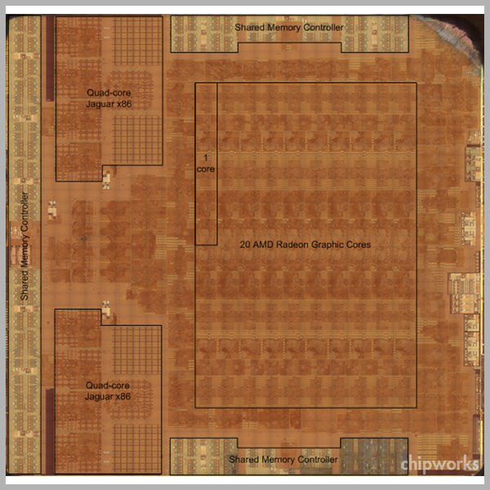
Multicore CPU

Slide 144
Manycore GPU (SIMT)
GPU architecture is a hybrid between SIMD and MIMD
SIMD cores apply a single instruction stream (thread) to multiple data “lanes” in parallel
To hide latency, many threads share a SIMD core via time-slicing
Nvidia calls this single instruction multiple thread (SIMT)
We’ll dive into GPU architecture later (time permitting)…

Slide 145
Computer Clusters, Grids and the Cloud
Computer cluster: Multiple homogenous computers, rack-mounted in close proximity, connected via fast local network
Grid computing: Loosely coupled heterogeneous computers (e.g., SETI@home)
Cloud computing: On-demand computing and storage
Software as a Service (SaaS)
Insert-flavor-here as a Service (XaaS)
Flexible, scalable, cost-effective
use only what you need, pay as you go

Slide 146
Lock-based Thread Synchronization

Slide 147
Concurrent Programming is Hard
Concurrent programming is significantly more difficult than sequential programming
Many of the assumptions, techniques, data structures that work well in sequential programs break down in concurrent situations
New classes of bugs; new problems; new constraints
Requires a data-oriented mindset
Requires understanding of target hardware
Simultaneous data access is the concurrency problem
Solving this problem requires new techniques!

Slide 148
Race Conditions
A race condition is a situation in which the behavior of a software (or hardware) system is dependent upon the sequence or timing of events

Slide 149
Critical Races
Not all race conditions have detrimental effects
e.g., doesn’t matter in what order weapon ray casts are processed during a single frame
A critical race condition is one that causes incorrect behavior

Slide 150
Data Races
A data race is a specific kind of race condition:
Two or more instruction streams (threads) operating on shared data
Depending on the exact timing, results of reads or writes of shared data become inconsistent
Data races are the concurrency problem!

Slide 151
What Does a Data Race Bug Look Like?
Intermittent or “random” behavior/crashes
Incorrect results
Data structures that get into “impossible” states
Bugs that magically disappear in debug builds
Bugs that are around for a while, then go away for a few days, then return again
Adding logging (printf() debugging) causes the bug to disappear
Heisenbugs!

Slide 152
Incrementing a Shared Counter
Consider the assembly code to increment a global variable:
What happens if two threads both run this code?
g_count:
dw 0 ; global 'g_count' inited to zero
increment_count:
mov [g_count], eax
inc eax
mov eax, [g_count]

Slide 153
Incrementing a Shared Counter
Answer: It depends!
Depends on the hardware
Depends on the operating system

Slide 154
Incrementing a Shared Counter
On an Apple II
One program at a time
Each program “takes up” the whole computer
No threads
No problem!
On a Windows 3.1 system
Cooperative multitasking
No threads
Process A runs program, then yields to Process B
No problem!

Slide 155
Incrementing a Shared Counter
On a single-core PC or game console with preemptive multitasking:
(e.g., Win95/NT and beyond, Linux, …)
Cannot predict when a thread’s time quantum will expire!
Preemption can happen at any time

Slide 156
Incrementing a Shared Counter
Expectation: It should work like this…

Slide 157
Incrementing a Shared Counter
Works reliably because first increment operation runs to completion before second one begins
Thread 0
Thread 1
Read
Incr
Write
…
Read
Incr
Write
…
time

Slide 158
Incrementing a Shared Counter
But the code actually contains a race condition, which can strike when preemption happens at the “wrong” time:
Thread 0
Thread 1
Thread 0
Read
Read
Incr
Write
…
Incr
Write
…
time

Slide 159
Thread A
Thread B
Thread A
Core
Read
Read
Incr
Write
…
Incr
Write
time
Thread A
Core 0
Read
Incr
Write
Thread B
Core 1
Read
Incr
Write
time
Thread A
Core 0
Read
Incr
Write
Thread B
Core 1
Read
Incr
Write
time

Slide 160
Excercise
Be the computer!
5 minutes

Slide 161
Incrementing a Shared Counter
This is what the incorrect behavior looks like…

Slide 162
Fine-Grained Data Race
Increment race can happen on a multicore machine with true parallelism
… but for a slightly different reason
Now the same instruction might actually execute in two or more threads at exactly the same time
Instructions take multiple clock cycles to run, so overlap between instructions might be complete or partial
Thread 0
F
D/R
E
M
W
F
D/R
E
M
W
Thread 1
F
D/R
E
M
W
F
D/R
E
M
W
time
time

Slide 163
Coarse-Grained Data Race
A data race can also occur between multiple processes reading/writing to a shared disk file
Single writer, single reader
Single writer, multiple readers
Multiple writers
e.g., two processes each write a 32 KiB block to a shared file
Process A opens file, writes its first 4 KiB chunk
Process B then opens the file, writes its first 4 KiB chunk
Meanwhile A continues writing—corruption!

Slide 164
Solution to Data Race Problem
What was the crux of the problem with incrementing a shared counter?
The increment operation could be interrupted part-way through
To avoid data races we need a way to make certain critical operations atomic (uninterruptible)

Slide 165
Making an Operation Atomic
There are various ways to make an operation atomic
Hardware- and OS-dependent
The specifics differ between single- and multiprocessor machines
Most reliable: Use thread synchronization primitives provided by the operating system
Mutexes
Critical sections
Semaphores
Condition variables/events

Slide 166
Making an Operation Atomic
Use of these primitives is called lock-based programming
Reliable but also
expensive (mutexes involve kernel calls)
It’s also possible to write lock-free algorithms
Much trickier to get right
Can perform better than lock-based approaches
More fault-tolerant
We’ll discuss lock-free and wait-free algorithms later…

Slide 167
Mutexes
A mutex is a thread-safe locking mechanism
Basically a Boolean variable
1 = locked
0 = not locked
Only one thread or process can “hold” the lock at any given time
Locking and unlocking are atomic operations
std::mutex in C++11

Slide 168
Mutexes
Typical mutex API
lock() or acquire()
If mutex is unlocked, lock it and return immediately
If mutex is locked, block the thread until it is unlocked…
... then lock it and return
NOTE: Thread could be blocked for a long time!
unlock() or release()
Unlock the mutex and return immediately
try_lock() or try_acquire()
If mutex is unlocked, lock it and return true immediately
If mutex is locked, return false immediately

Slide 169
Atomic Increment with Mutex (C++11)
#include <mutex>
std::mutex g_mutex;
void atomic_increment(int* pValue)
{
g_mutex.lock(); // safe to increment -- atomic operation ++*pValue;
g_mutex.unlock();
}

Slide 170
Atomic Increment with Mutex (POSIX)
#include <pthread.h>
pthread_mutex_t g_mutex;
void atomic_increment(int* pValue)
{
pthread_mutex_lock(&g_mutex); // safe to increment -- atomic operation ++*pValue;
pthread_mutex_unlock(&g_mutex);
}

Slide 171
Critical Sections
A critical section represents a “locked” chunk of code
A section of code that operates atomically
Really just another form of mutex
#include <windows.h>
CRITICAL_SECTION g_critsec;
void atomic_increment(int* pValue)
{ EnterCriticalSection(&g_critsec); ++*pValue; LeaveCriticalSection(&g_critsec);
}

Slide 172
Critical Sections
int main()
{ InitializeCriticalSection(&g_critsec); // spawn some threads that use the crit sec HANDLE hThread = CreateThread(...); // do some useful work... // wait for thread(s) to complete WaitForSingleObject(hThread); DeleteCriticalSection(&g_critsec); return 0; }

Slide 173
Critical Sections
Under Windows, a critical section is cheaper than a mutex (in the uncontended case)
A mutex can be shared between multiple processes
As such, locking and unlocking a mutex requires a context switch into kernel mode → expensive!
A critical section can only be used by threads within a single process
Therefore possible to use a spin lock (runs in user space) to implement a critical section → cheaper!
A critical section only falls back to a kernel call (mutex) if it spins for too long (times out)

Slide 174
Semaphores
A semaphore allows multiple threads to use a shared resource simultaneously (a mutex allows just one)
It’s a synchronization object that maintains a count N between 0 and N_{max}
Create the semaphore with fixed max count (N_{max}) and initial count (typically N = N_{max})
A thread “locks” a semaphore by waiting for it
This decrements its count: N = N – 1
A thread “unlocks” a semaphore by releasing it
This increments its count: N = N + 1

Slide 175
Semaphores
Semaphore is signaled when N > 0, and nonsignaled when N = 0
The first N_{max} threads won’t actually wait… their calls to WaitForSingleObject() will succeed and return immediately
Any threads over and above N_{max} will block when they call WaitForSingleObject()
They’ll wake up once some other thread(s) have released their locks on the semaphore via ReleaseSemaphore()

Slide 176
Scoped Locks
It’s easy to forget to unlock a mutex, leave a critical section, etc.
void DoThreadSafeWork() {
g_mutex.lock(); if (conditionA) return;
for (auto x : collection) { if (!IsValid(x))
return;
DoStuff(x); } g_mutex.unlock(); }

Slide 177
Scoped Locks
Better idea: Use a scoped lock (janitor)
class LockJanitor { std::mutex* m_pMutex; public:
LockJanitor(std::mutex* pMutex) : m_pMutex(pMutex) { m_pMutex->lock(); } ~LockJanitor() { m_pMutex->unlock(); } }

Slide 178
Scoped Locks
std::mutex g_mutex;
void DoThreadSafeWork() {
LockJanitor j(&g_mutex); if (conditionA) return;
for (auto x : collection) { if (!IsValid(x))
return;
DoStuff(x); } }

Slide 179
Scoped Locks (C++11)
std::mutex g_mutex;
void DoThreadSafeWork() {
std::lock_guard<std::mutex> guard(g_mutex); if (conditionA) return;
for (auto x : collection) { if (!IsValid(x))
return;
DoStuff(x); } }

Slide 180
Thread-Safe Functions
A thread-safe function is one that locks a mutex internally in order to provide the illusion of it being an atomic operation
Convenient, but…
Can lead to a tendancy amongst programmers to hold locks for too long
Lock... file my taxes... unlock
Such functions are not reentrant
a() calls b() calls c() … calls a()
Deadlock because a() already holds the lock!

Slide 181
Thread-Safe Functions
Ideas to mitigate problems with thread-safe functions
Hold locks for minimal time
Aim for as close to “lock-free” as possible
void NotGreat(args) {
g_mutex.lock(); // do huge amount of work... g_mutex.unlock(); }
void Better(args) {
g_mutex.lock(); WorkItem workItem(args); g_workQueue.enqueue(workItem); g_mutex.unlock(); }
void ProcessWorkItems() { for (workItem : g_workQueue) // do huge amount of work... }

Slide 182
Thread-Safe Functions
If an operation needs to be done atomically, write an unsafe version and then call it from a safe version
This supports reentrant calls
… or use reentrant locks (we’ll discuss these shortly...)
void DoWorkNoLock() {
if (conditionA) return;
for (auto x : collection) { if (!IsValid(x))
return;
DoStuff(x); } }
void DoWork () {
g_mutex.lock(); DoWorkNoLock(); g_mutex.unlock(); }

Slide 183
Condition Variables
Mutexes (et al) allow us to protect access to shared data
But sometimes we need one thread to synchronize with another thread
e.g., to send a signal to another thread
Useful when implementing a producer/consumer model

Slide 184
Condition Variables
Could just busy-wait (“spin”), like this:
std::atomic guarantees that reads and writes of this variable will be done atomically
std::atomic<int> g_ready = 0;
void producer()
{ // do some work, produce some data...
g_ready = 1; }
void consumer()
{
pthread_create(producer);
// do other useful work...
while (!g_ready) /*spin*/;
// consume the data...
}

Slide 185
Condition Variables
Using Busy-Wait
pthread_create(producer);
core0
while (!g_ready) { }
consume(&g_data);
core1
produce(&g_data);
time
g_ready = 1;

Slide 186
Condition Variables
Blocking calls allow one thread to wait until another thread has completed a task…
lock(): Sleep until the other thread releases a mutex
join(): Sleep until the other thread has terminated
However, the kernel decides when to wake up the blocked thread
Other threads can only control this process indirectly
A condition variable (aka event) is a mechanism which allows one thread to “wake up” another explicitly

Slide 187
Condition Variables
A condition variable is essentially a queue of threads that are waiting for a condition to become true
Threads sleep rather than busy-wait
Kernel wakes them when the condition becomes signaled
Condition variable object provides (at least) two functions:
wait() causes a thread to sleep and place itself on the queue until the condition variable becomes signaled
signal() puts the condition variable into its signaled state, thereby waking all sleeping threads

Slide 188
Condition Variables
Using Condition Variable
pthread_create(producer);
pthread_cond_wait(&g_cond, &g_mutex);
core0
other_thread
consume(&g_data);
zzz…
wake!
core1
produce(&g_data);
pthread_cond_signal(&g_cond);

Slide 189
Condition Variables
Condition variables are always used in conjunction with a mutex and a predicate (e.g., g_ready flag)
The mutex is used to prevent race conditions during the process of putting threads to sleep
The predicate indicates when producer has produced its data
Sadly, the signaled state of the condition variable cannot be used as the predicate
The term “condition variable” is really a total misnomer!
It’s really a waiting thread queue

Slide 190
Condition Variables
Producer:
Lock mutex
Set g_ready flag to true
Signal the condition variable
Unlock mutex
Consumer:
Lock mutex
While (!g_ready)…
wait on condition variable
Unlock mutex

Slide 191
Condition Variables
#include <pthread.h>
pthread_mutex_t g_mutex;
pthread_cond_t g_cond;
bool g_ready = false;
void producer()
{ // produce some data...
pthread_mutex_lock(&g_mutex); g_ready = true; pthread_cond_signal(&g_cond); pthread_mutex_unlock(&g_mutex); }

Slide 192
Condition Variables
void consumer()
{ // do some other useful work...
// ready to consume data – wait
pthread_mutex_lock(&g_mutex); while (!g_ready)
pthread_cond_wait(&g_cond); pthread_mutex_unlock(&g_mutex); // got the data – consume it...
}

Slide 193
Condition Variables
Wait, won’t waiting on a condition variable with the mutex locked cause a deadlock?
No—kernel ensures the thread doesn’t go to sleep while still holding the lock on the mutex
If the condition variable isn’t signaled when the wait occurs, the kernel atomically…
Unlocks the mutex
Puts the thread to sleep
When the condition variable becomes signaled, the kernel atomically…
Wakes the thread
Re-locks the mutex

Slide 194
Condition Variables
Condition variables are sometimes called events
e.g., under MS Windows
Handle hEvent = CreateEvent(...);
void producer() {
// produce data... SetEvent(hEvent); // set event to signaled
}
void consumer()
{ WaitForSingleObject(hEvent)
// consume data... }

Slide 195
Under the Hood

Slide 196
Making an Operation Atomic
Start by asking: How do we make an operation atomic?
All operations are atomic on a serial computer (single CPU, no pipelining) with no compiler optimizations
Some operations are atomic “for free” on multicore computers (e.g. x86 mov instructions)
But it’s impossible to make operations in general without help from the kernel and/or the CPU
Operating system dependent!
Hardware dependent!

Slide 197
Making an Operation Atomic
First consider a single-core computer
What can cause our increment to be interrupted?
Hardware interrupt: can cause context switch
Compiler optimizations: can cause a read or write to be skipped, or instructions to be reordered
Out-of-order execution (OOO) in pipelined CPU can also cause instructions to be reordered
Solutions?
Disable interrupts to prevent preemption
Use volatile to prevent compiler optimizations

Slide 198
Making an Operation Atomic
Unfortunately this approach is not portable
Disabling interrupts is CPU-specific
Single-byte read or write is atomic on all CPUs…
… but multibyte reads and writes may or may not be
Can’t prevent instruction reordering with volatile
And... even disabling interrupts doesn’t work to solve the race problem on a multicore machine!

Slide 199
Getting Help from the CPU
To avoid data races reliably, we need…
the help of the CPU!
Some machine language instructions are atomic “for free”
e.g., on x86, aligned loads and stores up to the width of the data bus are automatically atomic (uninterruptible)
Special machine language instructions are provided to perform other multi-step operations atomically

Slide 200
Test and Set
Test and set (TAS) instruction:
Set a bit to 1, and
return its previous value (so it can be tested)
// pseudocode for test and set bool test_and_set(bool* pLock) { // atomically... const bool old = *pLock; *pLock = true; return old; }

Slide 201
Test and Set
Can use TAS to atomically “lock” a resource
This is called a spin lock because the thread spins in a tight loop while waiting for the lock to be free
Disadvantage of TAS: Boolean values only (single bit)
void spin_lock(bool* pLock) { while (test_and_set(pLock) == true) ; // someone else has lock – spin! }

Slide 202
Atomic Exchange
Some CPUs (e.g., x86) support an exchange instruction (xchg)
Swaps two registers, or a memory location and a register
On x86, this instruction is atomic (like mov)
// pseudocode for xchg instruction void xchg(register int r0, int* pAddr) { // atomically... register int rTemp = r0; r0 = *pAddr; *pAddr = rTemp; }

Slide 203
Atomic Exchange
Can use atomic xchg to implement a lock
Void spin_lock(bool* pLock) { register bool r0 = true; // pseudocode! do { xchg(r0, pLock); } while (r0); // if we get back false, // then the lock succeeded }

Slide 204
Compare and Swap
Compare and swap (CAS) extends TAS to n-bit words
A CPU may offer 8-bit, 16-bit, 32-bit and 64-bit variants of compare and swap
Not all CPUs (ISAs) support CAS
On x86 it’s called cmpxchg
// pseudocode for compare and swap bool cas(int* pValue, int oldValue, int newValue) { // atomically... if (*pValue == oldValue) { *pValue = newValue; return true; } return false; }

Slide 205
Compare and Swap
CAS can be used to implement atomic increment
and other atomic operations (and, or, etc.)
CAS suffers from the ABA problem
We read value A from the shared variable
Can’t tell if another thread wrote B and then A again
void atomic_increment(int* pValue) { while (true) { const int oldValue = *pValue; // atomic read const int newValue = oldValue + 1; if (cas(pValue, oldValue, newValue)) break; // success! } }

Slide 206
Load Linked / Store Conditional
A lot of modern CPUs split the compare and swap operation into two separate instructions
Load linked: Read a memory address and save the address in a special link register
Store conditional: If the address matches the one in the link register
then write the value and return 1
otherwise fail and return 0
SC works by “snooping” writes to the address in link reg
If a write is detected, clear link register to 0
https://www.youtube.com/watch?v=fuHwmyZXnPA

Slide 207
Load Linked / Store Conditional
Atomic increment with LL/SC
void atomic_increment(int* pValue) { do { const int oldValue = ll(pValue); const int newValue = oldValue + 1; } while (!sc(pValue, newValue)); }

Slide 208
Load Linked / Store Conditional
LL/SC advantages over CAS:
LL/SC does not suffer from ABA problem
LL/SC is “stronger” than CAS in this sense
Each instruction only uses two registers
Smaller instruction words, good for RISC
Much better for pipelined CPU architectures
cas
F
D/R
E
M
C
M2
W
ll
F
D/R
E
M
W
sc
F
D/R
E
M
W

Slide 209
Load Linked / Store Conditional
Load linked/store conditional supported by wide range of CPUs/ISAs
DEC Alpha: ldl_l/stl_c, ldq_l/stq_c
PowerPC: lwarx/stwcx, ldarx/stdcx
MIPS: ll/sc
ARM: ldrex/strex (ARMv6, v7), ldxr/stxr (v8)
RISC-V: lr/sc
The devil’s in the details
How many link registers are supported? one? multiple?
Link usually at granularity of a cache line
LL/SC is sometimes overly conservative (false failures)
Can emulate LL/SC on x86 with double-width cmpxchg

Slide 210
LL/SC and Cache Lines
On many CPUs, load linked/store conditional operates on an entire cache line
Any read or write anywhere in the cache line may invalidate the link register
As such, programmer must take steps to ensure multiple locks don’t lie within a single cache line
Know your hardware!

Slide 211
Barriers
The TAS, CAS or LL/SC instructions are only part of the picture
Instruction reordering can also cause your locks and other atomic operations not to function as expected!

Slide 212
Barriers
Reads and writes can be reordered…
by compiler optimizations,
by OOO execution logic on pipelined/superscalar CPU,
by the way the CPU interacts with memory and the cache hierarchy (effectively reordering reads and/or writes)

Slide 213
Barriers
To prevent instruction reordering, use a barrier
Also called a fence
A special machine language instruction creates the barrier
A barrier imposes a global ordering on instructions
within a single thread, and/or
across multiple threads
Instructions before the barrier cannot be reordered in such a way that they end up after it, or vice-versa

Slide 214
Memory Barriers
In addition to preventing instruction reordering, a multicore CPU that supports a memory cache hierarchy requires memory barriers
aka memory fences
Memory barriers prevent reads and writes to/from memory from being effectively reordered
Memory barriers serve as instruction reordering barriers as well
ISAs provide one set of barrier/fence instructions that serve both purposes

Slide 215
Memory Barriers
There are two fundamental kinds of memory barrier:
Release and acquire
void producer() { g_data = 42; __mb_release(); g_ready = 1; }
void consumer() { while (g_ready == 0) { } __mb_acquire(); use(g_data); }

Slide 216
Memory Barriers
Release semantics (write/store barrier)
Producer behavior
Prevents writes from being reordered past the barrier

Slide 217
Memory Barriers
Acquire semantics (read/load barrier)
Consumer behavior
Ensures that any read that appears after the barrier will have a consistent view of memory
In other words, it ensures that all writes by other cores are fully committed and available in local cache before the barrier can be passed

Slide 218
Memory Barriers
To truly understand release and acquire barriers, we need to delve into the MESI cache coherence protocol…
Talk by Christian Gyrling, Programming Director, Naughty Dog, Inc.

Slide 219
Memory Barriers
Summary
Producer:
Always write the data before setting the ready flag
Always put a release barrier between them
Consumer:
Of course read the ready flag before using the producer’s data
Always put an acquire barrier between them

Slide 220
Memory Barriers
Note that barriers are CPU-specific
Intel x86
release fence (sfence, __mb_release()): write barrier
acquire fence (lfence, __mb_acquire()): read barrier
bidirectional fence (mfence): full barrier
PowerPC:
Full sync: sync
Lightweight sync: lwsync
Enforce in-order execution of I/O: eieio
Instruction sync: isync
Notes:
… but these CPU-specific barriers are often “wrapped” in intrinsics or an API

Slide 221
Atomic Variables
C++11 provides a convenient means of dealing with data atomically—the atomic data type
std::atomic<class T> and std::atomic_flag
The atomic variable represents the state of the lock 1 = locked, 0 = not locked
Only std::atomic_flag is guaranteed to be lock-free
Atomics are convenient because, by default, they do the atomic operation and the memory barrier(s) for you

Slide 222
Producer/Consumer with std::atomic
#include <atomic> std::atomic_flag g_ready = false; std::atomic<int> g_data;
void producer() { g_data = 42; g_ready = true; }
void consumer() { while (!g_ready) { } use(g_data); }

Slide 223
Atomic Variables
Can use atomic variables to implement your own user-space spin-locks, or to write lock-free algorithms
NB: You can’t use an atomic to put a thread to sleep and wake it back up on a condition
Need help from the kernel to do that
i.e., non-blocking algorithms only

Slide 224
C++11 Memory Order
C++11 allows you to relax the use of memory barriers in conjunction with std::atomic variables
std::memory_order enumeration used to specify desired ordering semantics
Relaxed: Atomic operations guarantee only atomiticity, not ordering of instructions (no barriers)
Consume: A read performed with consume semantics guarantees that no other read or write within the same thread can be reordered before this read—in other words, this semantic disables compiler optimizations only

Slide 225
C++11 Memory Order
C++11
Acquire: A read performed with acquire semantics guarantees consume semantics, plus writes to the same address by other threads are guaranteed to be visible to this thread
Release: A write performed with release semantics guarantees that no other read or write in this thread can be reordered after it, and the write is guaranteed to be visible by other threads reading the same address
Acquire/Release: A “full” barrier that acts as both an acquire and a release barrier

Slide 226

C++11 Memory Order
C++11 “relaxed” memory orders should only be used:
If you can prove through profiling that using a full barrier is actually a bottleneck
You really know what you’re doing!
It’s very easy to get “relaxed” memory order wrong and introduce bugs
Be careful out there!

Slide 227
Implementing a Spin Lock
Given what we’ve learned, implement a spin lock
Lock()
Release()
TryLock()
Assume you have an Atomic32 class with this API:
Exercise 10 minutes
class Atomic32 { public: I32 Get() const; // get value atomically
void Set(I32 value); // set value atomically
I32 CompareAndSwap(I32 newVal, I32 expectedVal); };

Slide 228
Implementing a Spin Lock
void SpinLockAtomic32(Atomic32* pAtomic) { const I32 kLockValue = -1; // 0xFFFFFFFF while (1) { // Only CAS if it is likely we'll succeed. if (!pAtomic->Get()) { // Spin until successful CAS. if (!pAtomic->CompareAndSwap(0, kLockValue)) break;
}
EMIT_PAUSE_INSTRUCTION();
}
// Prevent aggressive out-of-order prefetching // from reading memory too early. Memory::AcquireBarrier();
}
Notes:
Here’s roughly the implementation we use at Naughty Dog…

Slide 229
Implementing a Spin Lock
// For better system performance we don't want to spin-lock // without running a 'pause' instruction between every // iteration of the loop. This is better for power // consumption and the 'pause' instruction will only // yield the execution for a handful of cycles (~40).
// http://software.intel.com/en-us/comment/1134767
// http://software.intel.com/en-us/forums/topic/309231
//
#if defined(PLAT_WIN) || defined(PLAT_PS4)
#define EMIT_PAUSE_INSTRUCTION() _mm_pause()
#else
#define EMIT_PAUSE_INSTRUCTION() // nothing #endif

Slide 230
Implementing a Spin Lock
bool TryLockAtomic32(Atomic32* pAtomic)
{
const I32 kLockValue = -1;
// If CAS returns 0, we successfully locked.
bool lockAcquired = false;
if (!pAtomic->CompareAndSwap(0, kLockValue))
{
lockAcquired = true;
// Prevent aggressive out-of-order // prefetching from reading memory too early.
Memory::AcquireBarrier();
}
return lockAcquired;
}

Slide 231
Implementing a Spin Lock
void ReleaseLockAtomic32(Atomic32* pAtomic)
{
// Ensure that any data generated is written // before the flag is reset.
Memory::ReleaseBarrier();
pAtomic->Set(0);
// Attempt to force the released lock into // the cache hierarchy ASAP.
Memory::FullBarrier();
}

Slide 232
Reader/Writer Locks
A reader/writer lock allows either:
multiple readers or
a single writer
to acquire the lock.
LockForRead()
LockForWrite()
UnlockForRead()
UnlockForWrite()
Exercise 15 minutes

Slide 233
Reader/Writer Locks
void LockForRead(AtomicLock32* pAtomic)
{
// Spin until we successfully increment the lock count.
while (true)
{
// MSbit is the writer bit.
// Remainder are reader ref count bits.
I32 oldLock = (I32)(pAtomic->Get() & 0x7FFFFFFFU);
I32 newLock = oldLock + 1; // increment ref count
if (pAtomic->CompareAndSwap(oldLock, newLock) == oldLock)
break;
}
// Prevent aggressive out-of-order prefetching from reading
// memory too early.
Memory::AcquireBarrier();
}

Slide 234
Reader/Writer Locks
void UnlockForRead(AtomicLock32* pAtomic)
{
// Ensure that any data generated is written before
// the flag is reset.
Memory::ReleaseBarrier();
const I32 prevVal = pAtomic->Subtract(1);
ASSERT(prevVal > 0);
}

Slide 235
Reader/Writer Locks
void LockForWrite(AtomicLock32* pAtomic)
{
// Spin until we successfully lock.
while (true)
{
// MSbit is the writer bit.
// Only acquire if no readers hold lock.
U32 oldLock = 0U;
U32 newLock = 0x80000000U;
if (pAtomic->CompareAndSwap(oldLock, newLock) == oldLock)
break;
}
// Prevent aggressive out-of-order prefetching from // reading memory too early.
Memory::AcquireBarrier();
}

Slide 236
Reader/Writer Locks
void UnlockForWrite(AtomicLock32* pAtomic)
{
// Ensure that any data generated is written
// before the flag is reset.
Memory::ReleaseBarrier();
const U32 prevVal = pAtomic->Set(0);
ASSERT(prevVal == 0x80000000U);
}

Slide 237
Reentrant Locks
Problem: Retrofitting old code, difficult to properly lock reentrant functions
Solution: Make a lock that supports reentrancy
Same job can re-lock the same lock
Lock keeps a count of how many times it’s been locked
Lock ++
Unlock – –
Exercise 10 minutes

Slide 238
Reentrant Locks
class ReentrantLock64
{
protected:
Atomic64 m_atomic;
I32 m_refCount;
public:
ReentrantLock64() : m_atomic(0), m_refCount(0) { }
void AcquireLock();
bool TryAcquireLock();
void ReleaseLock();
bool IsLocked() const { return (m_atomic.Get() != 0); }
I32 GetRefCount() const { return m_refCount; }
bool IsOwnedByCurrentThread() const
{ return Thread::GetCurrentId() == m_atomic.Get(); }
};

Slide 239
Reentrant Locks
void ReentrantLock64::AcquireLock()
{
const U64 ownerId = Thread::GetCurrentId();
if (m_atomic.Get() != ownerId)
{
while (true)
{
// Try to atomically acquire ownership.
if (!m_atomic.CompareAndSwap(0, ownerId))
break;
EMIT_PAUSE_INSTRUCTION();
}
}
++m_refCount;
Memory::AcquireBarrier();
}

Slide 240
Reentrant Locks
bool ReentrantLock64::TryAcquireLock()
{
const U64 ownerId = Thread::GetCurrentId();
bool acquiredLock = false;
if (m_atomic.Get() == ownerId)
{
// Currently locked by the current thread.
acquiredLock = true;
break;
}
else
{
// Try to atomically acquire ownership.
if (!m_atomic.CompareAndSwap(0, ownerId))
{
acquiredLock = true;
break;
}
}
if (acquiredLock)
{
++m_refCount;
Memory::AcquireBarrier();
}
return acquiredLock;
}

Slide 241
Reentrant Locks
void ReentrantLock64::ReleaseLock()
{
Memory::ReleaseBarrier();
const U64 ownerId = Thread::GetCurrentId();
ASSERT(m_atomic.Get() == ownerId);
// Calling thread owns the lock: decrement counter.
--m_refCount;
if (m_refCount == 0)
{
// Release lock, which is safe b/c we own it.
m_atomic.Set(0);
}
}

Slide 242
Problems with Lock-based Concurrency

Slide 243
Problems with Lock-Based Concurrency
Lock-based concurrency is the simplest, most reliable way to synchronize threads in a shared memory system
However, it is prone to problems that don’t arise in a single-threaded program (and can also be avoided using lock-free or wait-free algorithms):
Deadlock
Livelock
Starvation
Priority inversion

Slide 244
Dining Philosophers Problem
Classic example of deadlock, livelock and starvation:
Dining philosophers problem

Slide 245
Dining Philosophers Problem
Five philosophers sit around the dinner table
Five forks on the table, one between each philosopher
Each philosopher can be in one of two states:
Thinking
Eating
In order to enter the Eating state, a philosopher must obtain two forks, one in each hand
Can grab either fork as soon as it becomes available
When leaving the Eating state, he puts down both forks
The philosophers never speak to one another

Slide 246
Dining Philosophers Problem
Problem statement:
Design a behavioral pattern (concurrent algorithm) that will allow all philosophers to alternate between thinking and eating ad infinitum without starving
Naïve solution:
Always grab left fork first, then right fork
If every philosopher grabs the left fork simultaneously…
then none of them will be able to grab the right fork!
Leads to a situation known as deadlock

Slide 247
Dining Philosophers Problem
Deadlock
zzz…
zzz…
zzz…
zzz…
zzz…

Slide 248
Deadlock
Deadlock can occur whenever…
two or more threads contend for
two or more locks
Every thread ends up going to sleep waiting on a lock held by a different thread
No thread can make progress

Slide 249
Deadlock
void thread0()
{ g_mutexA.lock();
g_mutexB.lock();
// ...
}
void thread1()
{ g_mutexB.lock();
g_mutexA.lock();
// ...
}
zzz…
zzz…
thread0
thread1
thread0
thread1
g_mutexA
g_mutexB

Slide 250
Deadlock
We can reason about deadlock by drawing connected graphs
Nodes represent threads (T_{i}) and resources (R_{j})
Directed edges represent locks
T → R: Thread T waiting for resource R
R → T: Resource R held/locked by thread T
Resource graph includes both the Ts and the Rs
Wait-for graph includes only the Ts
Cycles in wait-for graph = deadlocks

Slide 251
Resource Graphs and Wait-for Graphs
T₀
R₁
T₂
T₀
T₂
R₀
T₁
R₂
cycle = deadlock!
T₁
R₃

Slide 252
Livelock
Livelock is a situation in which threads can make some local progress, but are unable to make global progress
Happens in multithreaded programs when threads attempt to avoid deadlock by backing off and retrying
e.g., they all back off and then retry after the same amount of time
In other words, the state of the system can advance, but no thread ever gets to do any real work
Threads spend all their time backing off and retrying to lock resources

Slide 253
Dining Philosophers Problem
Let’s consider another solution to the dining philosophers problem:
Pick up left fork, then pick up right fork
If right fork isn’t available after waiting T minutes, put it back down and wait another T minutes before retrying
Seems promising…
Can always advance to a new state; deadlock is avoided
But can lead to a “stalemate” in which no philosopher ever gets both forks
This is an example of livelock!

Slide 254
Dining Philosophers Problem
Livelock

Slide 255
Dining Philosophers Problem
Livelock
timeout
timeout
timeout
timeout
timeout

Slide 256
Dining Philosophers Problem
Livelock
retry…
retry…
retry…
retry…
retry…

Slide 257
Dining Philosophers Problem
Livelock
Sigh…
This is getting old…
Facepalm…
LOLZ…
Ay ay ay!

Slide 258
Livelock
void thread0()
{ while (true) { g_mutexA.lock();
if (g_mutexB.trylock()) break; g_mutexA.unlock(); }
// ...
}
void thread1()
{ while (true) { g_mutexB.lock();
if (g_mutexA.trylock()) break; g_mutexB.unlock(); }
// ...
}
thread0
thread1
ad infinitum…
g_mutexA
g_mutexB

Slide 259
Starvation
What happens if a thread (or philosopher) is too greedy?
Runs (or eats) for extended period of time without releasing resources
This leads to a situation known as starvation
Common in programs using threads of different priorities all contending for the same resource
Lower-priority threads can be starved by higher-priority threads if they never get a chance to run (because a higher-priority thread is always waiting for the resource)

Slide 260
Exercise
Discuss possible solutions to dining philosophers problem in groups
10 minutes

Slide 261
Deadlock Conditions
Necessary and sufficient conditions for deadlock:
Mutual exclusion
Resources are shared, and only one thread can “lock” a resource at a time
Hold and wait
A thread must hold one lock while waiting for another resource to become available
No preemption of locks
Locks can only be released voluntarily
Cannot forcibly release a lock held by another thread
Circular wait
A cycle exists in the resource graph

Slide 262
Solutions to Deadlock Problem
Solutions to deadlock always involve removing one or more of the four necessary and sufficient conditions
Remove mutual exclusion
e.g., give each thread its own resource
Remove hold and wait
e.g., never hold more than one lock at a time
e.g., lock-free algorithms
Allow preemption of locks
e.g., kernel or supervisor thread could detect deadlock and “fix the glitch” by preempting a lock, forcing thread to re-try
Remove circular wait
e.g., impose a global ordering / resource priorities

Slide 263
Solutions to the Dining Philosophers Problem
Some common solutions to the dining philosophers problem:
Impose a resource hierarchy
Use a central arbitrator (the waiter)
Chandy/Misra solution
Banker’s algorithm

Slide 264
Solutions to the Dining Philosophers Problem
Resource hierarchy
Solution proposed by Dijkstra
Number the forks 0 through 4
A philosopher always picks up the lower-numbered fork first, then the higher-numbered one (of the two adjacent to him)
Can put down forks in any order
Analysis:
If four philosophers all pick up their lower-numbered fork, the fifth will be unable to pick up any forks
This allows one of the four to get his second fork and eat

Slide 265

Solutions to the Dining Philosophers Problem
0
1
0
0
1
1
2
4
2
4
3
2
3
3

Slide 266
Solutions to the Dining Philosophers Problem
Central arbitrator (the waiter)
Each philosopher asks the waiter for two forks
Waiter grants forks in a fair manner
Waiter can be implemented as a mutex
Either grab both forks, or grab no forks
Chandy/Misra solution
Forks can be marked dirty or clean
Messages sent between philosophers to request forks
If clean, keep it
If dirty, give it away
Imposes a priority: If you haven’t eaten in a while, you get to

Slide 267
Priority Inversion
What happens if a low-priority thread L obtains a lock on resource A, but then goes to sleep waiting on resource B?
A high-priority thread H will be unable to obtain a lock on resource A
As a result, the priority of thread L appears to be higher than the priority of thread H
Their priorities have been inverted

Slide 268
Priority Inversion
Priority inversion can also happen if a medium-priority thread M preempts thread L while it is holding the lock on resource A
Thread L locks resource A
Thread M preempts thread L, putting L to sleep
Thread H is again unable to obtain a lock on resource A

Slide 269
Priority Inversion
Possible consequences of priority inversion:
None
If thread L releases the resource quickly, thread H will be able to run and the inversion might go unnoticed
Perceived system slowdown
If thread H is starved of access to the resource for too long, the system can appear sluggish (e.g., if thread H is responding to user input)
System failure
Thread H can become so starved of access to the resource that system failures occur (e.g., missing a real-time deadline)

Slide 270
Concurrency In Game Engines

Slide 271
Concurrency in Game Engines
Let’s look at concurrent system design from the point of view of a game engine
Old-school single-core game engines worked like this:
// game loop! while (!g_quitGame) { ReadJoypads(); UpdateGameLogic(); AnimateSkeletons(); UpdateCollision(); SimulatePhysics(); RenderAudio(); RenderGraphics(); }

Slide 272
Concurrency in Game Engines
One Frame (33.3 ms @ 30 FPS)
Joypads
Game Objects
Animation
Collision
Physics
Audio
Graphics
CPU
time

Slide 273
Concurrency in Game Engines
How best to utilize multiple CPU cores?
Core 0
Joypads
Game Objects
Animation
Collision
Physics
Audio
Graphics
Core 1
Core 2
Core 3
time

Slide 274
Concurrent Problem Decomposition
When designing a concurrent/parallel system, we need to decompose the problem into tasks that can run concurrently/in parallel
Have to balance conflicting constraints
Look at the problem from various perspectives
Make design decisions that satisfy all constraints and produce best performance, ideally:
Maximum throughput
Acceptable latency

Slide 275
Task Versus Data Parallelism
First question: What type of parallelism?
Task parallelism: Multiple items of work (data transformations) running simultaneously
Data parallelism: A single transformation being applied to multiple data streams in parallel
Task parallelism naturally fits problems in which many different things need to get done
Data parallelism best fits problems in which a large quantity of data must be processed, but there are few/no dependencies between the data elements

Slide 276
Task Versus Data Parallelism
Example of task parallelism
Simulating one game frame involves running lots of heterogeneous tasks—do them in parallel
Joypad I/O, game object updates, animation, physics, …
Example of data parallelism
The graphics pipeline on a GPU
Transform and light thousands of vertices
Shade millions of pixels/fragments
GPU uses massive parallelism for maximum throughput

Slide 277
Concurrent Programming Models
Two basic forms of concurrent programming:
Message-passing
Shared memory
Examples of message-passing concurrency model:
Multiple processes running on different computers
Clusters, grid computing, cloud computing
Multiple processes within the same computer
Examples of shared memory concurrency model:
Multiple processes within the same computer (that share one or more virtual memory pages)
Multiple threads within a single process
Other methods (fibers, user threads, coroutines, …)

Slide 278
Concurrent Programming Models
Note that in a system where shared memory is available:
Message-passing can be implemented in terms of shared memory
Likewise, in a system that supports message-passing (such as a computer cluster or grid):
The illusion of shared memory can be implemented in terms of message-passing
This is called distributed shared memory

Slide 279
Concurrent Programming Models
Message-passing is usually implemented via:
Pipes between processes (same machine)
Network sockets (same machine or different machines)
Message queues (even within a single process)
Some languages focus on message-passing for concurrency:
Erlang
Go
Smalltalk
Rust

Slide 280
Concurrent Programming Models
Shared memory concurrency is prevalent in non-distributed systems
Such as game engines!
Single multithreaded process
Threads all share the process’s virtual memory space
Threads run possibly on multiple CPU cores, plus GPU
… plus DMAC, plus audio/video DSP chip, plus…?
Or could be multiple processes sharing memory pages
Or could be distributed shared memory

Slide 281
Concurrency in Game Engines
Simple idea: A few “fat” threads (task parallelism)
Game logic
Rendering
Physics?
Audio?

Slide 282
Concurrency in Game Engines
A few “fat” threads
BUT, audio and graphics depend on results of game logic, animation, physics…
One solution: Run audio and graphics one frame behind
Core 0
Joypads
Game Objects
Animation
Frame N
Core 1
Collision
Physics
Core 2
Audio
Frame N – 1
Core 3
Graphics
time

Slide 283
Concurrency in Game Engines
Overall throughput (frame rate) depends on slowest thread
T_{max} = max(T_{i}) for all threads i
Throughput R = 1/T_{max} (frames/second)
T_{max}
Core 0
Joypads
Game Objects
Animation
Frame N
Core 1
Collision
Physics
Core 2
Audio
Frame N – 1
Core 3
Graphics

Slide 284
Concurrency in Game Engines
Input lag depends on latency (length of time between reading joypads and seeing results on-screen)
T_{lag} = T_{game} + T_{render}
T_{game}
Core 0
Joypads
Game Objects
Animation
Frame N
Core 1
Collision
Physics
Core 2
Audio
Frame N – 1
Core 3
Graphics
T_{render}

Slide 285
Concurrency in Game Engines
And really there’s also time spent on the GPU, so…
T_{lag} = T_{game} + T_{render} + T_{gpu}
T_{game}
T_{render}
Game “Frame”
CPU
T_{gpu}
Render “Frame”
GPU
GPU “Frame”

Slide 286
Concurrency in Game Engines
PROBLEM: Lots of idle time
Core 0
Joypads
Game Objects
Animation
Frame N
Core 1
Collision
Physics
Core 2
Audio
Frame N – 1
Core 3
Graphics
time

Slide 287
Granularity
This leads to the next decision when designing any concurrent system:
At what granularity will tasks be divided?
For task parallelism, there’s a gamut of possibilities:
Extremely coarse
Rendering + “everything else”
Extremely fine
Every machine language instruction is a task!
Run instructions in parallel as much as possible (pipelining, superscalar and/or SIMD)
Constrained by dependencies between instructions

Slide 288
Granularity
For data parallelism, the nature of the data usually dictates the granularity gamut
e.g., multiplying matrices, we can subdivide in terms of:
Matrices
Rows of the matrices
Individual elements of the matrices (individual element-element multiplication operations)
… but those are pretty much our only choices

Slide 289
Concurrency in Game Engines
So let’s go with finer-grained parallelism in our engine…
How about one thread per logical unit of work?
Main thread can “farm out” work by creating worker threads
Synchronize by waiting for threads to terminate (join)

Slide 290
Concurrency in Game Engines
Core 0
Core 1
Core 2
Core 3
Joypads
Visibility
Game Objects
Now with MOAR THREADS!
Sort
Submit Primitives
Kick Anim
Pose Blending
Kick Phys
Broadphase
Post Anim Update
Matrix Palettes
Wait for GPU
Narrowphase
…
Ragdoll/Procedural Anim
Rigid Bodies
Post FX
Kick Rendering
Swap
time

Slide 291
Candidates for Multithreading
Low-hanging fruit:
Async File I/O
Show example of how this works
File decompression
Rendering vs game logic (one thread each? multiple?)
Thread for “optional” render effects (on PC, can LOD these effects to load-balance on less performant HW)
Audio/DSP
Physics sim
Network access (thread/job to handle each request?)

Slide 292
Concurrency in Game Engines
Another idea: fine-grained fork and join (data parallelism)
e.g., pose blending 10,000 joints
Maybe divide into groups of 2,500 joints
Process one batch per core (fork)
Wait for all batches to be done (join)
Then continue with work that isn’t as easily parallelizable (such as matrix palette generation, which requires us to “walk” the joint hierarchies)

Slide 293
Concurrency in Game Engines
Core 0
Divide into Batches
fork!
Core 0
Core 1
Core 2
Core 3
Process Batch
Process Batch
Process Batch
Process Batch
Core 0
join!
Calc Matrix Palettes…

Slide 294
Concurrency in Game Engines
Problems with “more threads” approach
Creating and destroying threads isn’t cheap
Kernel calls; context switches; kernel resources
Still too coarse-grained
Still quite a few “gaps” (idle time)
Too rigid
We’d like to be able to shift workloads around
From core to core
Change when each workload runs during the frame
… in order to fill the gaps

Slide 295
Job Systems
What we really want is a general-purpose job system
Support arbitrary workloads
Consistent way to kick them off, join (wait for completion)
Define a job as:
An entry point (function) to perform the work
Job parameters (priority, core affinity, etc.)
Input and output data buffers

Slide 296
Job Systems
Job system works by maintaining:
A job queue
A thread pool (or fiber pool)
New job requests are placed on the job queue
Jobs are scheduled by job system to run on the available threads
Job system provides mechanism for one job to wait on another job or a collection of jobs to complete (join)

Slide 297
Job Systems
A job system might be driven by a special “main thread”…
Core 0
Main Thread
Core 1
Job
Job
Job
Job
Job
Job
Job
Core 2
Job
Job
Job
Job
Job
Job
Job
Core 3
Job
Job
Job
Job
Job
Job
Job
time

Slide 298
Job Systems
Or maybe everything’s a job!
“It’s turtles all the way down.” – Anonymous
Core 0
Job
Job
Job
Job
Job
Job
Job
Core 1
Job
Job
Job
Job
Job
Job
Job
Core 2
Job
Job
Job
Job
Job
Job
Job
Core 3
Job
Job
Job
Job
Job
Job
Job
time

Slide 299
Degree of Concurrency
We’ve talked about implementing a job system… now how do we use it effectively?
We’re going to need a bit more theory…
The degree of concurrency (DOC) describes how many tasks could theoretically run in parallel
at a given moment in time, or
on average during an interval of time

Slide 300
Dependencies
The degree of concurrency that is achievable is dictated by the dependencies between tasks or data elements
Dependencies impose an order on tasks
For N tasks…
If there are no dependencies, DOC = N
If every task is dependent upon one other task, DOC = 1

Slide 301
Dependencies
Dependency Graph
A
B
F
DOC_{max} = 4
C
D
E
Possible Schedule on Four Cores
Core 0
A
Core 1
B
F
Core 2
C
D
Core 3
E
time

Slide 302
Dependencies
Dependency Graph
A
B
C
D
E
F
DOC = 6
Possible Schedule on Four Cores
Core 0
A
C
Core 1
B
Core 2
D
Core 3
F
E
time

Slide 303
Dependencies
Dependency Graph
A
B
C
D
E
F
DOC = 1
Possible Schedule on Four Cores
Core 0
A
B
C
D
E
F
Core 1
Core 2
Core 3
time

Slide 304
Dependencies
Dependency Graph
A
B
C
D
E
F
DOC = 1
Possible Schedule on Four Cores
Core 0
A
E
Core 1
B
F
Core 2
C
Core 3
D
time

Slide 305
Sync Points
Each dependency creates a sync point
A point in time at which multiple parallel tasks must synchronize in order to impose ordering
The first task to complete must wait until the last task completes
Every sync point creates the potential for inefficient use of system resources (hardware idle time)

Slide 306
Sync Points
Sync Points
Core 0
A
Core 1
B
F
Core 2
C
D
Core 3
E
time

Slide 307
Sync Points
Core 0
A
other
Core 1
B
Core 2
C
D
Core 0
A
other
other
Core 1
B
other
Core 2
C
other
other
D
time

Slide 308
int size = CalculateSize();
Item item = ProduceItem(size);
AddItemToQueue(&g_queue, item);
FreeItem(item);
printf("success!\n");
preamble
invocation
critical
response
postamble

Slide 309
call some_func
mov ebx,5
mul ebx,ecx
mov eax,[g_count]
inc eax
mov [g_count],eax
cmp ebx,ecx
be label
preamble
invocation
critical
response
postamble

Slide 310
Updating Game Objects Concurrently
Let’s apply these ideas to game object updates
How can we update game objects concurrently?
Most game engines simply don’t solve this problem
because it’s legacy code, written in single-threaded style
because it’s hard!
Core 0
J
Game Objects
Core 1
A
A
A
A
P
Core 2
A
A
A
A
P
Core 3
A
A
A
R
R
time

Slide 311
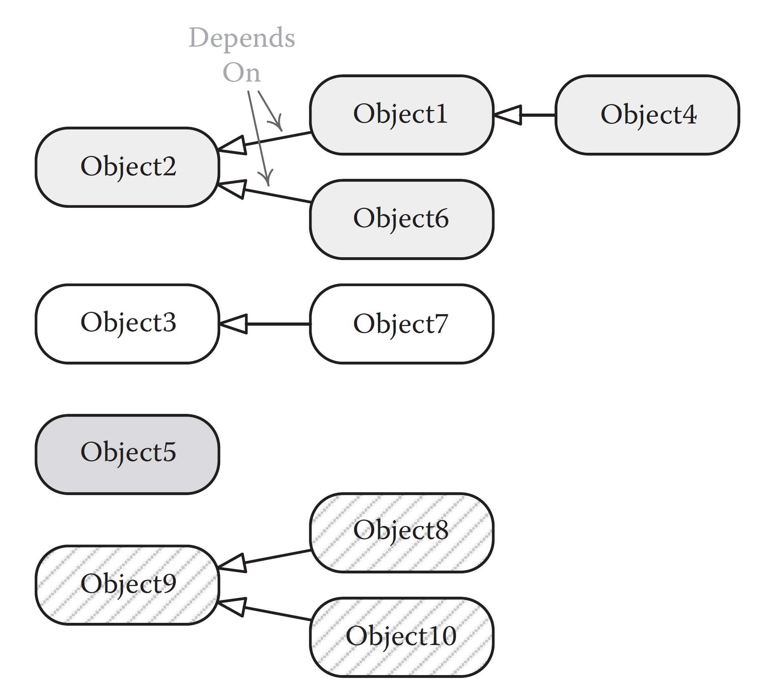
Updating Game Objects Concurrently
Game objects typically depend on one another

Slide 312
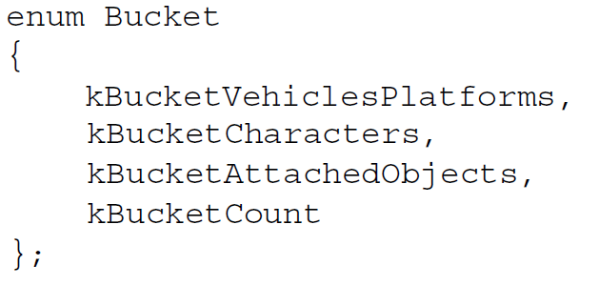
Updating Game Objects Concurrently
One way to deal with game object dependencies:
Bucketed updates

Slide 313
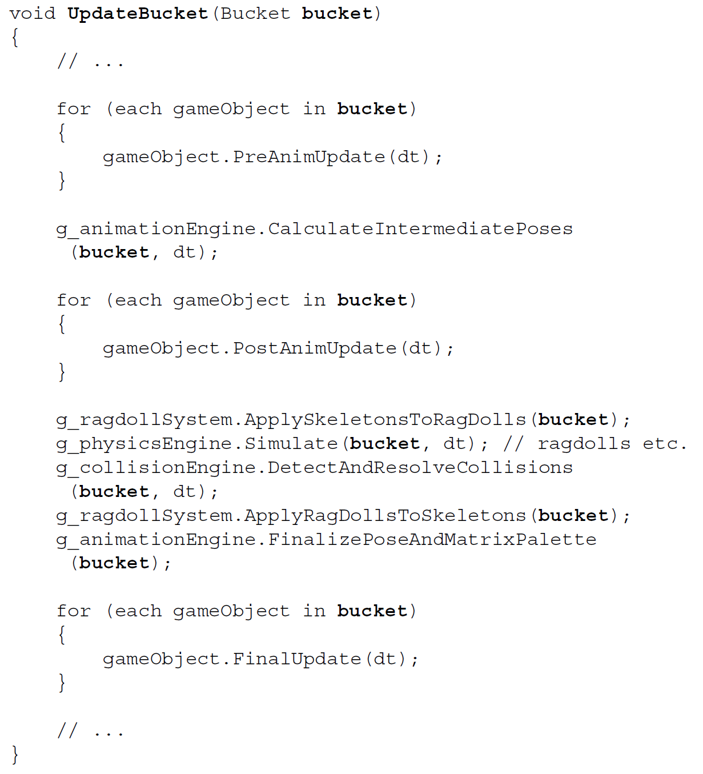

Slide 314
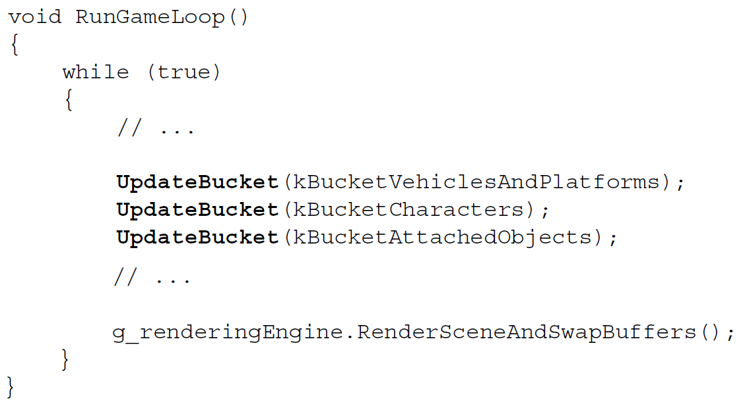

Slide 315
Updating Game Objects Concurrently
Dependency Graph
A
B
F
C
D
E
Possible Schedule on Four Cores
Core 0
A
Core 1
B
F
Core 2
C
D
Core 3
E
Bucket 0
Bucket 1
Bucket 2
time

Slide 316
Updating Game Objects Concurrently
Another alternative to bucketed updates is to define inter-object dependencies explicitly
Automated scheduler can create “buckets” dynamically
Update all objects with no dependencies, then
all objects with dependency depth 1, then
all objects with dependency depth 2,
and so on…
With a job system, each object update can be a job
Kick off a dependent job only after the job(s) on which it is dependent has/have completed

Slide 317
Updating Game Objects Concurrently
Dependency Graph
A
B
F
C
D
E
Possible Schedule on Four Cores
Core 0
A
Core 1
B
F
Core 2
C
D
Core 3
E
time

Slide 318
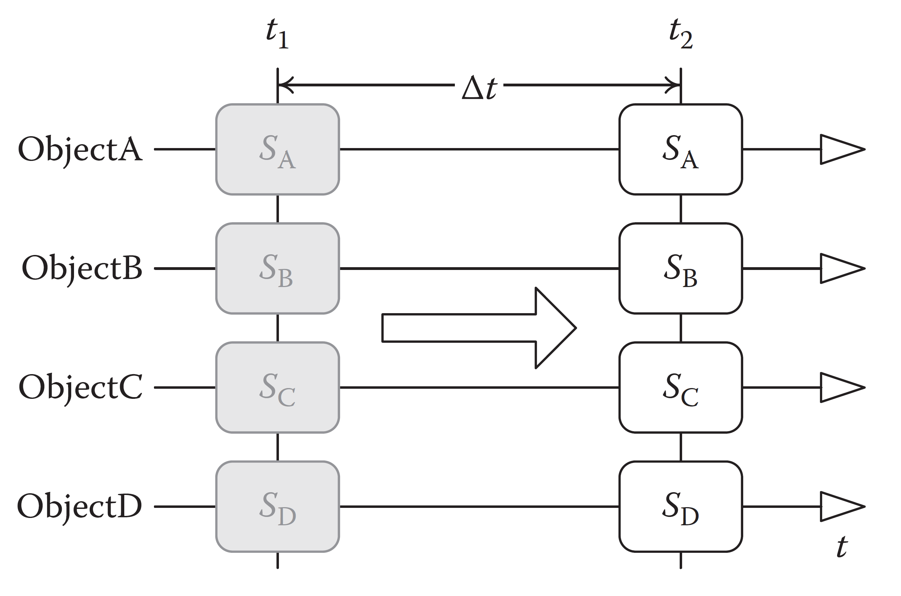
Updating Game Objects Concurrently
Ideally game object updates happen instantaneously

Slide 319
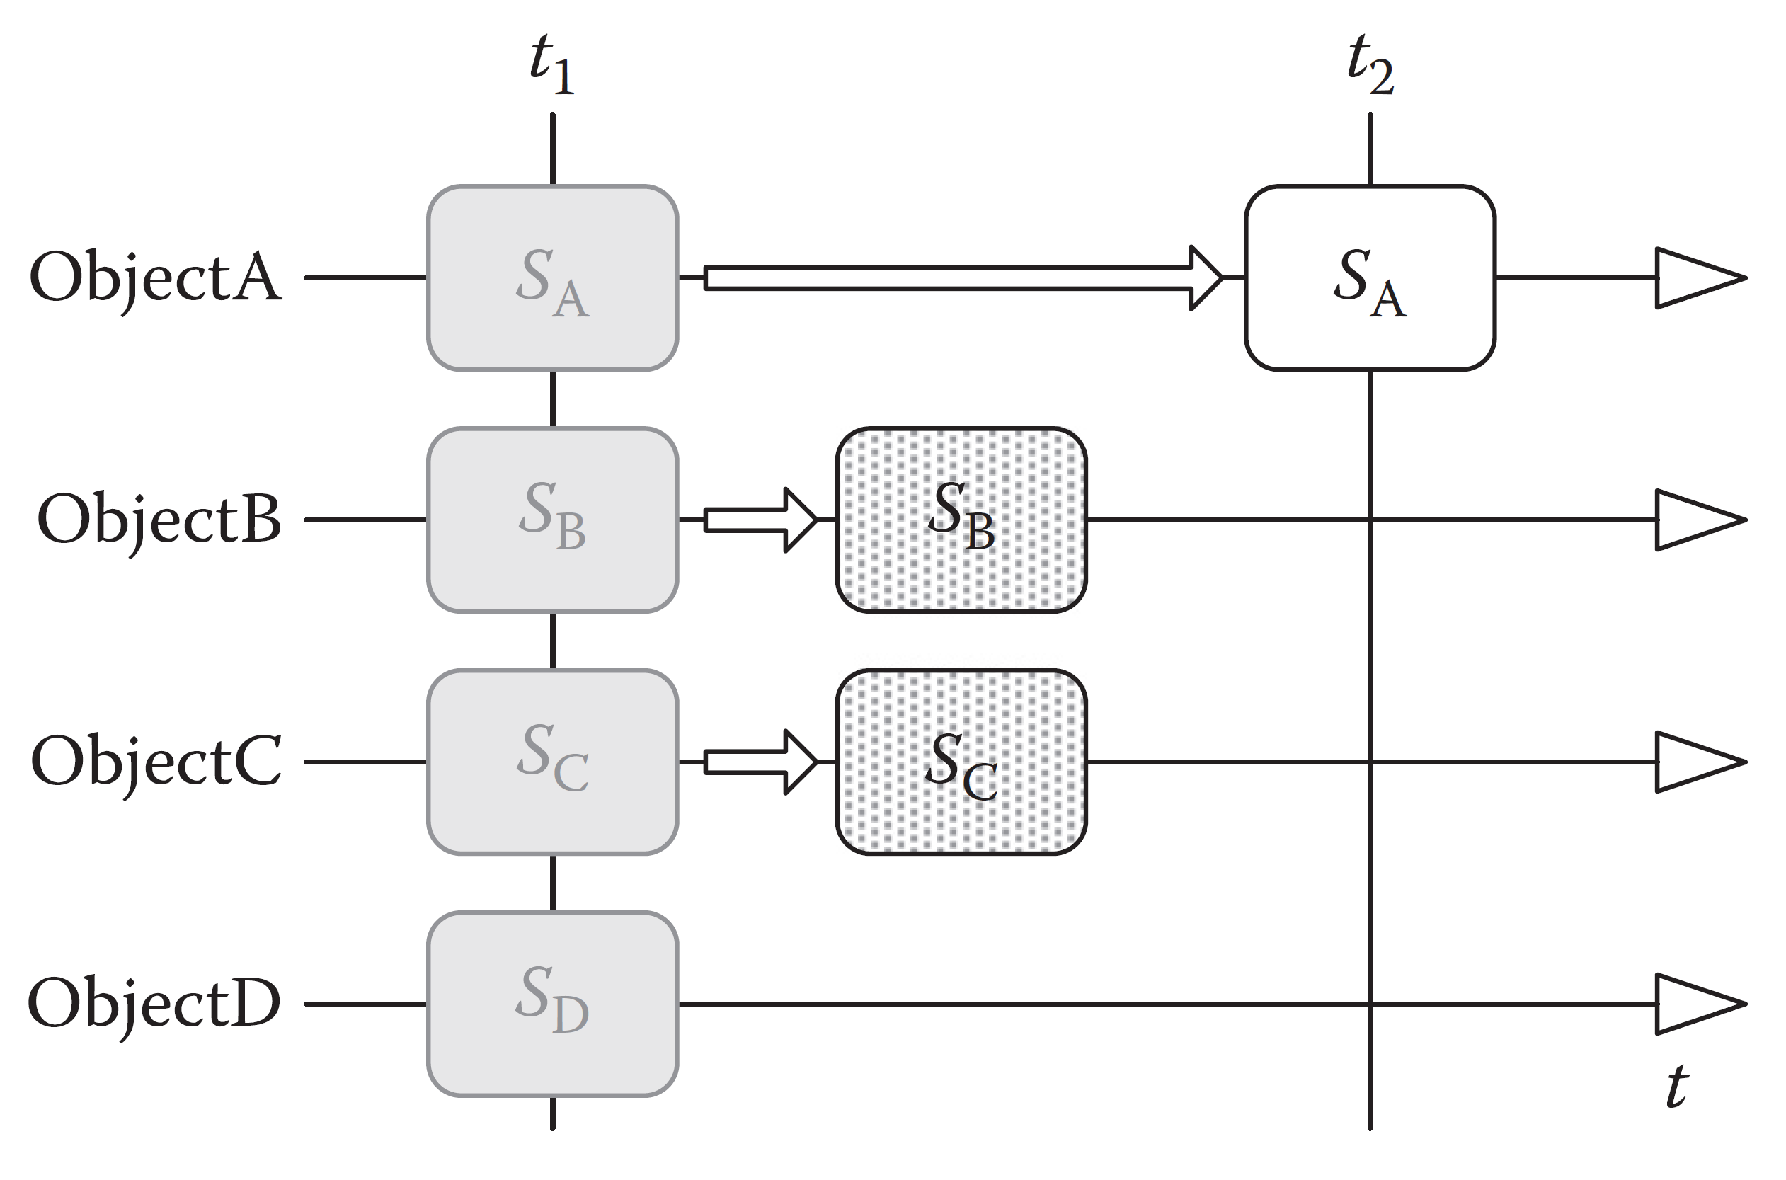
Updating Game Objects Concurrently
In reality, game object updates happen piecemeal

Slide 320
Updating Game Objects Concurrently
This makes inter-game-object dependencies trickier
When object A tries to read the state of object B, during frame n, there are three possibilities:
Object B has already been updated (state: frame n)
Object B has not yet been updated (state: frame n – 1)
Object B is in the process of being updated (concurrency!)

Slide 321
Updating Game Objects Concurrently
Solutions to inter-object reads:
General-purpose locks
Guarding each read and each update
Reader/writer locks
Can be locked by multiple readers or a single writer
Acquire a read lock to read state of game object
Game object acquires write lock to update itself
Other ideas?
5 minute discussion…

Slide 322
Updating Game Objects Concurrently
Solutions to inter-object reads:
Snapshots
Each game object maintains a copy of its internal state known as its snapshot
Readers only ever read the snapshots, never the “live” state of a game object
Multiple readers, but they can never read during a write
Therefore, no locks required!
After game object updates, it also updates its snapshot
This has to be done either within a lock, or
during a sync point when we know no reader jobs are running

Slide 323
Updating Game Objects Concurrently
Solutions to inter-object reads:
Snapshots
Problems with snapshots:
Still require lock / sync point to update the snapshot
Phased updates require multiple snapshot updates per frame, per object
Can only read the previous state of a game object (the state contained in the snapshot)
Leads to one-frame-off bugs

Slide 324
Updating Game Objects Concurrently
Another idea…
Double-buffered game object state
Each game object contains two copies of its state
While copy 1 is being updated, copy 0 available to be read
Swap buffers at end of update (atomically)
Suffers from many of the problems of snapshots:
Reading stale data; one-frame-off bugs

Slide 325
Updating Game Objects Concurrently
What about when process A wants to mutate process B?
Could use general-purpose or reader/writer locks
Other ideas?
5 minute discussion…

Slide 326
Updating Game Objects Concurrently
What about when process A wants to mutate process B?
What we do at Naughty Dog:
Minimize inter-object mutation wherever possible
Inter-object mutation between buckets is safe
Inter-object mutation within a bucket must be handled carefully…
With locks
Or by controlling update order
Or by requesting mutation that can be applied later (request queue)

Slide 327
ASSERT_LOCK_FREE()
First: Design your system so sync points are explicit and well-known
Design to minimize sync points
Design to eliminate or minimize contention
Next: Realize that locks aren’t needed if you can be sure when different pieces of code are running
e.g., don’t load new levels while unloading stale levels
If you can ensure unloading and loading never happen at the same time, then no lock is required!
Now: Instead of protecting your code with locks “just in case,” add assertions that a lock isn’t needed

Slide 328
ASSERT_LOCK_FREE()
Idea: ASSERT_LOCK_FREE()
Can be implemented using a global volatile bool rather than with a (more expensive) atomic
Doesn’t matter if it catches 100% of the cases, as long as it catches issues 95+% of the time
If the assert fires, you know you either:
Need a lock, or…
need to fix your design to be truly contention-free, or…
possibly it’s a false positive, but at least you know and can check it out

Slide 329
ASSERT_LOCK_FREE()
class AssertionAtomic
{
private:
volatile I64 m_atomic; // not a real atomic!
public:
AssertionAtomic() : m_atomic(0) { }
void ASSERT_LOCK_FREE(const char* callingFunc)
{
const I64 oldVal = m_atomic;//.Get();
ASSERTF(oldVal == 0ULL,
("LOCK NEEDED in %s!", callingFunc));
}

Slide 330
ASSERT_LOCK_FREE()
void PseudoLock(const char* callingFunc)
{
const I64 oldLock = 0LL;
const I64 curLock = m_atomic++;//.CompareAndSwap(oldLock, newLock);
ASSERTF(curLock == oldLock,
("LOCK NEEDED in %s!", callingFunc));
}
void PseudoUnlock(const char* callingFunc)
{
const I64 oldLock = 1LL;
const I64 curLock = m_atomic--;//.Set(0);
ASSERTF(curLock == oldLock,
("LOCK NEEDED in %s!", callingFunc));
}
};

Slide 331
ASSERT_LOCK_FREE()
Usage:
Acts like a reader/writer lock
Declare an AssertionAtomic globally, as if it were a global mutex or lock
Writers:
call g_atomic.PseudoLock()
… then do their work
... then call g_atomic.PseudoUnlock()
Readers:
call g_atomic.ASSERT_LOCK_FREE() prior to their work

Slide 332
Job System Implementation

Slide 333
Job System Implementation
Job systems can be implemented in all sorts of ways
One typical method: thread pools
Pool of pre-created threads
Cost of creating/destroying threads is mitigated
Work item = (config data + callback)
Placed in a queue
Scheduled to run on available threads

Slide 334
Job System Implementation
Another option: fibers
A fiber is basically a light-weight thread
A fiber is just an execution context
Registers + call stack
Context switches are very cheap (thread switch: 5,000 cycles!)
Runs within the context of a thread
Fibers can’t exist on their own
Key feature: Fibers don’t use preemptive multitasking
Programmer must explicitly switch to a new fiber
Means a job either runs to completion or explicitly yields

Slide 335
ND Job System
Naughty Dog job system uses fibers
Seven cores on PS4, so seven worker threads, each affinity-locked to a core
Pool of fibers provide execution contexts for jobs
Job decls, placed on job queues (various priorities)
Job system pulls jobs from the queue, assigns to a fiber, runs within a worker thread
i.e., schedules the job on a core

Slide 336
ND Job System
Jobs can wait on a counter
Waiting jobs put on a special wait queue, along with reference to counter being waited on
Job retains its execution context (fiber) while waiting
Registers, call stack
When counter hits zero, job is “woken up” (scheduled to a core again)

Slide 337
ND Job System
Object g_Objects[100];
JOB_ENTRY_POINT(AnimateObjectJob)
{
// ...
}
void AnimateAllObjects()
{
JobDecl jobDecls[100];
for (int jobIndex = 0; jobIndex < 100; ++jobIndex)
{
jobDecls[jobIndex] = JobDecl(AnimateObjectJob, &g_Objects[jobIndex]);
}
Counter* pJobCounter = NULL;
RunJobs(&jobDecls, 100, &pJobCounter);
WaitForCounterAndFree(pJobCounter, 0);
}

Slide 338
ND Job System
GDC talk by Christian Gyrling, Programming Director, Naughty Dog, Inc.
https://www.gdcvault.com/play/1022186/ Parallelizing-the-Naughty-Dog-Engine

Slide 339
Thinking Concurrently

Slide 340
Thinking Concurrently
This section is based on material from a great talk by Mike Acton, Engine Director, Insomniac Games Inc.
“Diving Down the Concurrency Rabbit Hole”
http://cellperformance.beyond3d.com/articles/public/ concurrency_rabit_hole.pdf

Slide 341
Thinking Concurrently
QUESTION:
Can concurrent systems programmers use “old school” data structures?
Just lock it, and then use it as if the system isn’t concurrent, right??

Slide 342
Thinking Concurrently
ANSWER:
It depends…
Concurrency is a data problem, not a code problem
Race conditions are the crux of the issue
Therefore, choosing the right data structure is the key to success

Slide 343
Thinking Concurrently
Some data structures are inherently sequential (single-threaded)
While others are suitable for concurrent access (multiple simultaneous readers/writers)
It’s always better to use the right tool for the job
Why try to shoe-horn an inappropriate data structure into any software solution (concurrent or not)?
Would you use a linked list when you need O(1) indexed access to the data?
Would you use an array when you need O(1) insertion?

Slide 344
Thinking Concurrently
Sometimes a sequential (single-threaded) data structure is appropriate in a concurrent system
… just as sometimes 2D math is useful for 3D problems
But concurrent access (reading/writing)…
introduces new constraints,
requires us to ask new questions,
requires us to think about the problem in new ways

Slide 345
Thinking Concurrently
Concurrency is about synchronizing access (reads and writes) to shared data
It’s a data problem, not a code problem
So, design your data for concurrency first
… then design your code to support that data
Programs aren’t concurrent—operations are
An efficient “concurrent program” spends the vast majority of its time doing work (sequentially; in isolation)
The concurrent operations (accesses of shared data) are minimized, ideally to the point of being negligible

Slide 346
Thinking Concurrently
Consider the ubiquitous doubly-linked list
Is this a concurrent data structure?
Why is a doubly-linked list designed the way it is?
Discussion: 5 min

Slide 347
Thinking Concurrently
A doubly-linked list
is designed for O(1) insertion and deletion
at any place in the list
Next and previous pointers impose an order
Moreover, code order == transformation order
e.g., given this dlinked list…
A
B

Slide 348
Thinking Concurrently
The following sequence of calls…
Insert(C after A)
Insert(D after A)
is guaranteed to yield this:
A
D
C
B

Slide 349
Thinking Concurrently
In other words, a doubly-linked list assumes:
Sequential access
Random access (insert or delete anywhere)
Every operation is instantaneous (atomic)
Insert followed immediately by Iterate is expected to yield the post-insertion state of the list

Slide 350
Thinking Concurrently
But what happens if multiple tasks (threads) attempt to mutate a shared dlinked list concurrently?
Thread A: Insert(C after A)
Thread B: Insert(D after A)
Which order would you expect to be “correct?”
A
D
C
B
A
C
D
B
A
crash!?
B

Slide 351
Thinking Concurrently
Concurrent operations require extra dimensions of information:
Global and local ordering requirements
Latency requirements
Throughput requirements
Access requirements
permissions, visibility of shared data

Slide 352
Ordering Requirements
You could attempt to determine who “won” the race
But this requires synchronized clocks in general
In a concurrent system, there really is no “now”
What time granularity is appropriate to “win?”
within one second? within one frame? within one nanosecond?

Slide 353
Ordering Requirements
More importantly, does the order matter at all?
Perhaps a coarse-grained “bucketed” order is all that’s needed
Or maybe an unordered list will suffice
The answers to these questions depend on the specifics of the problem you’re trying to solve
Ordered data structures require a global ordering rule
… which might be “the order doesn’t matter” (that’s still a rule!)

Slide 354
Latency Requirements
A concurrent operation always involves latency
Thinking concurrently requires us to break every operation into an invocation and response (completion)
Invoke A
A Complete
Invoke B
B Complete
Invoke C
C Complete
Invoke A
A Complete
Invoke B
B Complete
Invoke C
C Complete

Slide 355
Latency Requirements
Must ask: What are the latency requirements of this concurrent operation?
When do other threads need to be able to “see” the results of the op?
Next frame?
Before the next sync point?
Within T milliseconds?
Never? (i.e., a local operation—no concurrency needed!)

Slide 356
Throughput Requirements
What are the throughput requirements of the system?
Can usually trade latency for throughput
Increased latency → increased throughput
If clients can wait for results (higher latency), then:
there’s less contention over locks,
less waiting,
fewer sync points,
higher throughput

Slide 357
The Five Ws
Always ask who, what, where, when, why:
Who is allowed to access the data?
Who can read? Who can write?
What data needs to be shared (concurrently accessed)?
What data can be local/private to a thread?
Where does shared data live? Ownership?
When can the data be read? mutated?
How long after a mutation do the results need to be “visible?”
Why does the data need to be shared?
Can sharing be limited or restricted? Avoided?

Slide 358
Exercise: Request Queue
Design a concurrent data structure to handle a request queue…
… for characters saying lines of dialog
Lines can be triggered by any character (or inanimate game object like a radio)
at any time during the game object update phase
Game object update runs in parallel on multiple cores
5 minutes

Slide 359
Exercise: Request Queue
One possible solution:
Global, lock-free or lock-protected, singly linked list
append only
order unimportant
time granularity = one frame
Single sync point after all game objects have updated
Audio system reads request queue after this sync point
checks rules (e.g., is character allowed to speak? should we interrupt what (s)he is already saying?)
kicks off the lines of dialog, which will be heard next frame

Slide 360
Exercise: Request Queue
Another idea:
Multiple request queues, one per thread
No locking required when adding requests to local queues!
No locking required when reading queues, either!
… thanks to the sync point after game object update
Or, if we want to allow adding new requests while processing the queue…
the audio system can make a copy of the queue, then clear it, atomically
Any new requests made after this will be for next frame

Slide 361
Exercise: Request Queue
Feed-forward designs like this dialog request queue are commonplace, and highly effective!
e.g., the Naughty Dog engine uses feed-forward to transfer data from the game frame to the render frame
FrameParams struct contains copy of all data needed to render a frame
Allocate a new FrameParams each frame, populated by game frame, consumed by render frame
Lifetime of FrameParams generated by game frame i is…
… until GPU is done rendering frame i
Requires a ring buffer allocator

Slide 362
Rules of Thumb for Concurrency

Slide 363
Rules of Thumb
In this section, we’ll talk about some high-level rules of thumb for designing and implementing concurrent systems
Not an exhaustive list
YMMV
Experience is the best teacher!

Slide 364
Rules of Thumb
Divide your data into global and local pools
Minimize global (shared) data
Try to make most data local (private to one thread)
e.g., dialog system request queue:
instead of one shared queue, use one queue per thread—coalesce the queues later at a single sync point

Slide 365
Rules of Thumb
Make a clear distinction between readers and writers
Multiple readers + multiple writers is the hardest case to handle correctly/efficiently
Can we reduce to single writer, multiple readers? (easier)
Can we reduce to single writer, single reader? (best)

Slide 366
Rules of Thumb
Hold locks for minimal length of time
e.g., instead of: (lock, do long task, unlock)…
prefer (lock, enqueue request, unlock) and then (do long task) later, asynchronously

Slide 367
Rules of Thumb
Minimize sync points (synchronize rarely)
Don’t wait for something you don’t have to!
Make use of existing sync points, rather than introduce new ones, wherever possible
In hardware: Preexisting kernel/blocking calls
In software: Frame boundaries, bucket boundaries, …

Slide 368
Rules of Thumb
Division of labor should be
fine-grained enough for scheduling flexibility, but
coarse-grained enough so that job system overhead doesn’t dominate

Slide 369
Rules of Thumb
Consider “chunky” data manipulation
e.g., reading a file in large chunks (or perhaps more importantly, naturally-sized chunks given the specifics of the hardware/driver)
e.g., fill a local queue, then send a single request to process the queue(s) once per frame (or at specific sync points)

Slide 370
Rules of Thumb
Defer operations to improve performance
Upon request to do work, don’t do it—queue it
Useful for “collecting” work requests for processing by a central arbiter / single worker thread
Provides flexibility—can move code to a suitable place within the frame (to fill a “hole”)
Supports correctness—can defer until after a sync point

Slide 371
Rules of Thumb
Double-buffering / n-way buffering
e.g., client thread adds requests to request buffer 0,
while server thread consumes requests from buffer 1
At some reasonable sync point (end of “frame”), flip buffers atomically
e.g., multithreaded game object updating: each game object could double-buffer its state
Last frame’s state (freely readable, no locks required)
This frame’s state (actively being updated)

Slide 372
Rules of Thumb
Prefer immutable data
Feed data forward rather than mutating it in place
More copying, yes, but that cost is less than sync costs
And it’s a lot easier to reason about!
This is why functional programming languages are good for concurrency!
e.g., Lisp/Scheme, Haskell, F#
But you can program in functional style in any language

Slide 373
Rules of Thumb
Think in terms of asynchronous operations
Kick off a request now…
… get the results later
Requires refactoring of synchronous code (common in single-threaded programs) to operate asynchronously

Slide 374
Rules of Thumb
Think in terms of transactions
A transaction may complete successfully…
… or it might fail, be rolled back, and re-tried
Designing this way opens the door to lock-free algorithms
Prepare the transaction locally (can be time-consuming)…
… then “publish” it in one brief (possibly lock-free) concurrent operation
Again, minimize duration of critical sections!

Slide 375
Rules of Thumb
Know your hardware
A sequential CPU without pipelining has a sync point after every instruction
Concurrent programming becomes trivial!
Compiler optimizations and OOO execution guarantee correctness only for a sequential program
Concurrency requires programmer intervention!
You can’t be more concurrent than your HW allows
CPU time is discrete, not continuous
Clock rate defines minimum time quantum
What synchronization tools does the CPU provide? (CAS, LL/SS, memory barriers)

Slide 376
Rules of Thumb
Know your hardware
Understand how the various synchronization primitives work under the hood
Know the relative costs of different kinds of prims
e.g., knowing that CriticalSection is cheaper than Mutex on Windows
Know how your target compiler, CPU does pipelining, OOO execution, speculative exec / branch prediction
Can code to avoid pitfalls of these systems
For max performance, it’s useful to know how to write lock-free concurrent operations
Spin locks, lock-free counters, lock-free queues, …

Slide 377
Introduction to Lock-Free Programming

Slide 378
Cost of Synchronization
The cost of a mutex lock can be high
… even in the no-contention case
i.e., when no other thread is competing for the lock
High cost is due to:
Pipeline stall introduced in order to sync
Cache coherency systems are also impacted
Memory barriers
Context switch into kernel space to mutate the lock
2,000 cycles just to get into ring 0...
often 5,000 cycles for context switch
which means 10,000 cycles there and back!

Slide 379
Cost of Synchronization
Impossible to avoid pipeline stalls and memory barrier costs
But it is possible to avoid context switch costs...

Slide 380
Cost of Synchronization
The key is to figure out how to synchronize multiple threads while remaining in user space
No context switch into kernel space
Solution: Lock-free algorithms
Important: There’s still a sync point going on!
Not really lock-free in that sense
But:
The lock is performed in user space
The lock is much cheaper, esp. in uncontended case
The duration of the lock is minimal (a few cycles)
Threads can never go to sleep while holding a lock

Slide 381
Non-Blocking Guarantees
Shared memory concurrent algorithms can be placed into the following categories, in order of increasing “strength” of the guarantees they make
Lock-based/blocking (least strong)
Obstruction-free
Lock-free
Wait-free (strongest)

Slide 382
Non-Blocking Guarantees
Lock-based/blocking
Individual threads may sleep for extended periods of time while waiting for a resource to become available
Subject to deadlock, livelock, etc.
Obstruction-free
A single thread will complete its operation in a bounded number of steps, assuming all other threads are blocked
Demands only that partially-complete transaction can be aborted and rolled back if interrupted by another thread
Lock-free is stronger and easier to achieve (obstruction-free is usually more like a bug in a lock-free algorithm!)

Slide 383
Non-Blocking Guarantees
Lock-free
No thread ever sleeps while waiting for a shared resource
Threads that fail to obtain access to a resource fail and re-try, rather than sleeping
In other words, over a sufficiently long period of time at least one thread in the system can always make progress
Still subject to starvation problem
Wait-free
Adds starvation-freedom to the requirements of lock-freedom

Slide 384
Should We Write Lock-Free Code?
For high-performance code, we can strive toward the ideal of lock-free or wait-free algorithms
But remember the 80/20 rule
Lock-free and wait-free is much harder to get right; more difficult to maintain
Strive toward ≠ achieve at all costs
Profile first
Address the specific performance issues you actually have
If the best solution is to go lock-free, go for it
Otherwise, stick to solutions that are simpler, easier to reason about, easier to maintain

Slide 385
Lock-Free Queue
We can implement a lock-free queue as a singly-linked list
API
Construct
Append (push_front())
Iterate (begin(), end())
Clear (clear())
Destroy
Only Append and Clear need be concurrent / lock-free
We can read the list freely with no locks

Slide 386
Lock-Free Queue
Here’s what the code would look like for a traditional (sequential, non-concurrent) Append operation
// Node* m_pHead;
template<class T>
void SinglyLinkedList<T>::push_front(T data) {
auto pNode = new Node;
pNode->m_data = data;
pNode->m_pNext = m_pHead; m_pHead = pNode->m_pNext;
}

Slide 387
Lock-Free Queue
How can we implement this as a lock-free concurrent operation?
Hint: Use std::atomic and compare_exchange_weak()
Exercise: 5 mins

Slide 388
Lock-Free Queue
The trick to lock-free Append is to
prepare the new node beforehand,
head
A
B
C
D

Slide 389
Lock-Free Queue
The trick to lock-free Append is to
prepare the new node beforehand,
then patch it into the list with a single compare-and-swap (CAS) instruction
head
A
B
C
D

Slide 390
Lock-Free Queue
// std::atomic<Node*> m_pHead;
template<class T>
void SinglyLinkedList<T>::push_front(T data) {
auto pNode = new Node;
pNode->m_data = data;
do {
pNode->m_pNext = m_pHead; } while (!m_pHead.compare_exchange_weak(pNode->m_pNext, pNode));
// We expect m_pHead to still point to node we read... // but if it changed in the meantime, fail and re-try!
}

Slide 391
Lock-Free Queue
We can clear() the list using CAS again
Read the current head node
Use CAS to clear m_pHead to nullptr
Fail and retry if m_pHead no longer points to the same node
i.e., another thread did an insert in the interim

Slide 392
Lock-Free Queue
Atomic CAS (or LL/SC), combined with fail-and-retry is the key to most lock-free algorithms
Sometimes a “blind write” is sufficient, no need to retry
… in which case, use compare_exchange_strong()

Slide 393
Atomic Snapshot Objects
An atomic snapshot object acts like a collection of N single-writer, multi-reader atomic registers
Provides a Snapshot operation which returns what appears to be the state of all N registers at once
The “trick” is to implement a collect operation
Iterate over all N registers and copy their values
Two successive collects that return the same values is a successful snapshot
http://www.cs.yale.edu/homes/aspnes/pinewiki/AtomicSnapshots.html

Slide 394
SIMD and GPU Programming

Slide 395
SIMD Programming
To understand GPU programming, it’s a good idea first to understand SIMD programming on the CPU
We’ll look at Intel SSE2 and AVX here
Other ISAs support SIMD vector processing
Concepts are very similar

Slide 396
SIMD Programming
SSE2 and AVX are evolutions of earlier SIMD ISAs
MMX, SSE
Capable of operating in various modes
128-bit XMM registers can hold four 32-bit floats,
or two 64-bit doubles,
or 16 8-bit ints, 8 16-bit ints, 4 32-bit ints, 2 64-bit ints
AVX registers are twice as wide as SSE2
256-bit YMM registers can hold eight 32-bit floats,
or four 64-bit doubles,
Or 32 8-bit ints, 16 16-bit ints, 8 32-bit ints, 4 64-bit ints

Slide 397
SIMD Programming
We’ll focus on XMM registers/SSE2, treated as a group of four 32-bit floats
32 bits
32 bits
32 bits
32 bits
x
y
z
w

Slide 398
SIMD Programming
SSE2 assembly instructions exposed to C/C++ via compiler intrinsics
Look like function calls, but really emit raw assembly
Key API:
__m128 _mm_load_ps(const float* alignedData);
void _mm_store_ps(__m128 vec, float* alignedData);
__m128 _mm_add_ps(__m128 a, __m128 b);
__m128 _mm_mul_ps(__m128 a, __m128 b);

Slide 399
SIMD Programming
// selects two fields from a, two fields from b
__m128 _mm_shuffle_ps(__m128 a, __m128 b, unsigned mask);
#define SHUFMASK(p,q,r,s) (p | (q<<2) | (r<<4) | (s<<6)) __declspec(align(16)) float a[] = { 40.0f, 41.0f, 42.0f, 43.0f };
__declspec(align(16)) float b[] = { 80.0f, 81.0f, 82.0f, 83.0f };
__m128 va = _mm_load_ps(a);
__m128 vb = _mm_load_ps(b);
__m128 vr = _mm_shuffle_ps(va, vb, SHUFMASK(2, 3, 1, 1));
// vr == { 42.0, 43.0f, 81.0f, 81.0f } in this example
// vr == { va[p], va[q], vb[r], vb[s] } in general

Slide 400
SIMD Add Arrays
Let’s look at how to vectorize a simple loop
void addArrays_ref(const float* dataA, const float* dataB, float* results, int count)
{
for (int i = 0; i < count; ++i)
{
results[i] = dataA[i] + dataB[i];
}
}

Slide 401
SIMD Add Arrays
We can use SIMD to add four floats every instruction
void addArrays_sse2(const float* dataA, const float* dataB, float* results, int count)
{
for (int i = 0, i < count; i += 4)
{
__m128 a = _mm_load_ps(&dataA[i]);
__m128 b = _mm_load_ps(&dataB[i]);
__m128 r = _mm_add_ps(a, b);
_mm_store_ps(&results[i], r);
}
}

Slide 402
SIMD Batched Dot Product
How about calculating a bunch of four-element dot products?
void dotArrays_ref(float r[], const float a[], const float b[], int count)
{
for (int i = 0; i < count; ++i)
{
const int j = i * 4;
r[i] = a[j+0]*b[j+0] // ax*bx
+ a[j+1]*b[j+1] // ay*by
+ a[j+2]*b[j+2] // az*bz
+ a[j+3]*b[j+3]; // aw*bw
}
}

Slide 403
SIMD Batched Dot Product
Vectorize as before—this time we are required to “add across a register”…
void dotArrays_sse2(float r[], const float a[], const float b[], int count)
{
for (int i = 0; i < count; ++i)
{
const int j = i * 4;
__m128 va = _mm_load_ps(&a[j]); // ax,ay,az,aw
__m128 vb = _mm_load_ps(&b[j]); // bx,by,bz,bw
__m128 v0 = _mm_mul_ps(va, vb); // do the four multiplies
__m128 v1 = _mm_hadd_ps(v0, v0); // add across the register // (v0w+v0z, v0y+v0x, v0w+v0z, v0y+v0x)
__m128 vr = _mm_hadd_ps(v1, v1); // add across the register // (v0w+v0z+v0y+v0x, v0w+v0z+v0y+v0x, v0w+vt2+v0y+v0x, v0w+vt2+v0y+v0x)
_mm_store_ss(&r[i], vr); // extract vr.x as a float
}
}

Slide 404
SIMD Batched Dot Product
void dotArrays_sse2_transposed(float r[], const float a[], const float b[], int count) {
for (int i = 0; i < count; i += 4)
{
__m128 vaX = _mm_load_ps(&a[(i+0)*4]); // a[0,1,2,3]
__m128 vaY = _mm_load_ps(&a[(i+1)*4]); // a[4,5,6,7]
__m128 vaZ = _mm_load_ps(&a[(i+2)*4]); // a[8,9,10,11]
__m128 vaW = _mm_load_ps(&a[(i+3)*4]); // a[12,13,14,15]
__m128 vbX = _mm_load_ps(&b[(i+0)*4]); // b[0,1,2,3]
__m128 vbY = _mm_load_ps(&b[(i+1)*4]); // b[4,5,6,7]
__m128 vbZ = _mm_load_ps(&b[(i+2)*4]); // b[8,9,10,11]
__m128 vbW = _mm_load_ps(&b[(i+3)*4]); // b[12,13,14,15]
_MM_TRANSPOSE4_PS(vaX, vaY, vaZ, vaW); // vaX = a[0,4,8,12], vaY = a[1,5,9,13], ...
_MM_TRANSPOSE4_PS(vbX, vbY, vbZ, vbW); // vbX = b[0,4,8,12], vbY = b[1,5,9,13], ...
__m128 result;
result = _mm_mul_ps(vaX, vbX);
result = _mm_add_ps(result, _mm_mul_ps(vaY, vbY));
result = _mm_add_ps(result, _mm_mul_ps(vaZ, vbZ));
result = _mm_add_ps(result, _mm_mul_ps(vaW, vbW));
_mm_store_ps(&r[i], result);
}
}
… but if we transpose the data…

Slide 405
SIMD Batched Dot Product
#define _MM_TRANSPOSE4_PS(row0, row1, row2, row3) { \
__m128 tmp3, tmp2, tmp1, tmp0; \
\
tmp0 = _mm_shuffle_ps((row0), (row1), 0x44); \
tmp2 = _mm_shuffle_ps((row0), (row1), 0xEE); \
tmp1 = _mm_shuffle_ps((row2), (row3), 0x44); \
tmp3 = _mm_shuffle_ps((row2), (row3), 0xEE); \
\
(row0) = _mm_shuffle_ps(tmp0, tmp1, 0x88); \
(row1) = _mm_shuffle_ps(tmp0, tmp1, 0xDD); \
(row2) = _mm_shuffle_ps(tmp2, tmp3, 0x88); \
(row3) = _mm_shuffle_ps(tmp2, tmp3, 0xDD); \
}

Slide 406
SIMD Batched Dot Product
Performance* on my Intel Core i7
dotArray_ref(): 1400.00 cycles
dotArray_sse2(): 1537.00 cycles
dotArray_sse2_transposed(): 359.00 cycles
*Cycle counts gathered in this manner aren’t reliable, but this gives us at least a rough idea of relative performance

Slide 407
SIMD Batched Square Root
What about performing a batch of square roots?
In this case, we need an if check to prevent sqrt(negative)
#include <cmath> void sqrtArray_ref(float* __restrict__ r,
const float* __restrict__ a,
unsigned count)
{
for (unsigned i = 0; i < count; ++i)
{
if (a[i] >= 0.0f) r[i] = std::sqrt(a[i]); else r[i] = 0.0f;
}
}

Slide 408
SIMD Batched Square Root
Vectorize…
#include <xmmintrin.h> void sqrtArray_sse2(float* __restrict__ r,
const float* __restrict__ a,
unsigned count)
{ __m128 zero = _mm_set1_ps(0.0f);
for (int i = 0; i < count; i += 4)
{ __m128 va = _mm_load_ps(a + i); __m128 vr;
if (_mm_cmpge_ps(va, zero)) // ??? vr = _mm_sqrt_ps(va); else vr = zero; _mm_store_ps(r + i, vr);
}
}

Slide 409
SIMD Batched Square Root
Problems:
The if check produces a control hazard
Bad for pipelining
The if check also prevented the compiler from automatically vectorizing our non-SSE2 loop

Slide 410
SIMD Partial Predication
The solution? Vector select!
e.g., AltiVec vec_sel(va, vb, mask) intrinsic vr = vec_sel(va, vb, mask);
In lanes where mask=0xFFFFFFFF, move vb.x→vr.x
In lanes where mask=0x00000000, move va.x→vr.x
int Max(int a, int b)
{
int result;
if( a < b )
result = b;
else
result = a;
return result;
}
vector int Max(vector int a, vector int b)
{
vector bool int mask = vec_cmplt(a, b);
vector int result = vec_sel(a, b, mask); return result;
}

Slide 411
SIMD Partial Predication
No vector select in SSE2, but can use and+or...
__m128 _mm_vecsel_ps(const __m128& a, const __m128& b, const __m128& mask)
{
// (b & mask) | (a & ~mask)
__m128 bmask = _mm_and_ps(b, mask);
__m128 anotmask = _mm_andnot_ps(mask, a);
return _mm_or_ps(bmask, anotmask);
}

Slide 412

SIMD Partial Predication
Or we could get really clever and use exclusive or...
__m128 _mm_vecsel_ps(const __m128& a, const __m128& b, const __m128& mask)
{
// (((b ^ a) & mask) ^ a)
__m128 bxora = _mm_xor_ps(b, a);
return _mm_xor_ps(a, _mm_and_ps(mask, bxora));
}
https://markplusplus.wordpress.com/2007/03/14/fast-sse-select-operation/

Slide 413
SIMD Batched Square Root
#include <xmmintrin.h> void sqrtArray_sse2_pred(float* __restrict__ r,
const float* __restrict__ a,
unsigned count)
{ __m128 zero = _mm_set1_ps(0.f);
for (unsigned i = 0; i < count; i += 4)
{
__m128 va = _mm_load_ps(a + i);
__m128 mask = _mm_cmpge_ps(va, zero);
__m128 sqrt = _mm_sqrt_ps(va); // might be QNaN
__m128 vr = _mm_vecsel_ps(zero, sqrt, mask);
_mm_store_ps(r + i, vr);
}
}

Slide 414
SIMD Vector/Matrix Multiplication
Exercise: Write an SSE2 function to multiple a 4-element vector by a 4×4 matrix
Bonus: Use this function to multiply two 4×4 matrices
union Mat44 {
float m[4][4];
__m128 row[4];
};
__m128 mulVecMat_sse2(const __m128& v, const Mat44& M); void mulMatMat_sse2(Mat44& R, const Mat44& A, const Mat44& B);

Slide 415
SIMD Vector/Matrix Multiplication
union Mat44 {
float m[4][4];
__m128 row[4];
};
__m128 mulVecMat_sse2(const __m128& v, const Mat44& M) {
__m128 result = _mm_mul_ps(_mm_shuffle_ps(v, v, 0x00), M.row[0]);
result = _mm_add_ps(result, _mm_mul_ps(_mm_shuffle_ps(v, v, 0x55), M.row[1]));
result = _mm_add_ps(result, _mm_mul_ps(_mm_shuffle_ps(v, v, 0xAA), M.row[2]));
result = _mm_add_ps(result, _mm_mul_ps(_mm_shuffle_ps(v, v, 0xFF), M.row[3])); return result;
}
These shuffles replicate v_{x}, v_{y}, v_{z} and v_{w} across all four SIMD lanes

Slide 416
SIMD Vector/Matrix Multiplication
void mulMatMat_sse2(Mat44& R, const Mat44& A, const Mat44& B)
{
R.row[0] = mulVecMat_sse2(A.row[0], B);
R.row[1] = mulVecMat_sse2(A.row[1], B);
R.row[2] = mulVecMat_sse2(A.row[2], B);
R.row[3] = mulVecMat_sse2(A.row[3], B);
}

Slide 417
GPU Architecture
Manycore/SIMT

Slide 418
Manycore GPU (SIMT)
Typical CPU core
Fetch/Decode
Cache
ALU
Execution Context (Registers)
Out-of-order execution Branch predictor Memory prefetch
http://haifux.org/lectures/267/Introduction-to-GPUs.pdf

Slide 419
Manycore GPU (SIMT)
Remove fancy OOO logic, branch predictor, cache
Fetch/Decode
ALU
Execution Context (Registers)
http://haifux.org/lectures/267/Introduction-to-GPUs.pdf

Slide 420
Manycore GPU (SIMT)
Duplicate 16 times
http://haifux.org/lectures/267/Introduction-to-GPUs.pdf

Slide 421
Manycore GPU (SIMT)
Group 16 ALUs and 16 execution contexts, managed by one fetch/decode unit to make a SIMD unit
Four SIMDs per compute unit (CU) = 64 “lanes”
SIMD Unit
CU
SIMD
SIMD
SIMD
SIMD
http://haifux.org/lectures/267/Introduction-to-GPUs.pdf

Slide 422
Manycore GPU (SIMT)
https://www.amd.com/Documents/GCN_Architecture_whitepaper.pdf

Slide 423
Manycore GPU (SIMT)
Vectorization of shader code can be implicit (automatic) or explicit
sample r0, v4, t0, s0 mul r3, v0, cb0[0] madd r3, v1, cb0[1], r3 madd r3, v2, cb0[2], r3 clmp r3, r3, l(0.0), l(1.0) mul o0, r0, r3 mul o1, r1, r3 mul o2, r2, r3 mov o3, l(1.0)
vec16_sample vr0, vv4, t0, vs0 vec16_mul vr3, vv0, cb0[0] vec16_madd vr3, vv1, cb0[1], vr3 vec16_madd vr3, vv2, cb0[2], vr3 vec16_clmp vr3, vr3, l(0.0), l(1.0) vec16_mul vo0, vr0, vr3 vec16_mul vo1, vr1, vr3 vec16_mul vo2, vr2, vr3 vec16_mov o3, l(1.0)
http://haifux.org/lectures/267/Introduction-to-GPUs.pdf

Slide 424
Manycore GPU (SIMT)
Time-slice between multiple threads to hide stalls (SIMT)
http://haifux.org/lectures/267/Introduction-to-GPUs.pdf

Slide 425
Manycore GPU (SIMT)
Time-slice between multiple threads to hide stalls (SIMT)
Therefore need to keep around more contexts, for rapid context switching between them
SIMD Unit

Slide 426
Manycore GPU (SIMT)
Many CUs on one GPU die
e.g., PS4 GPU (~Radeon HD 7870) has 18 CUs
4×16×18 = 1,152 ALUs / “lanes”
GPU
CU
CU
CU
CU
CU
CU
CU
CU
CU
CU
CU
CU
CU
CU
CU
CU
CU
CU
L2 Cache

Slide 427
https://www.amd.com/Documents/GCN_Architecture_whitepaper.pdf

Slide 428
Manycore GPU (SIMT)
Branches: Execute both the if and the else!
Use 16×32-bit mask to select results conditionally
http://haifux.org/lectures/267/Introduction-to-GPUs.pdf

Slide 429
GPU Programming Models
How do we program a GPU?
Write geometry, vertex, pixel shaders (for graphics), or
Write compute shaders (GPGPU)
Loops that perform a single, relatively simple operation on a large quantity of data are suitable for GPGPU
Consider a loop that iterates over and processes N data items
Typical workflow:
Write the loop for CPU, test, get it working
Convert the body of the loop into a GPU kernel
GPU will run the loop body N times, in parallel, across the SIMD units within one or more CUs

Slide 430
GPU Programming Models
Programmer writes “single-threaded” kernel, kicks it off for execution on the GPU
Single-threaded kernel is vectorized by compiler/GPU so it can be run in parallel on the SIMDs within a CU
Each “lane” is called a thread
A group of threads running on a SIMD is called a wavefront

Slide 431
GPU Programming Models
// CPU version for (int i = 0; i < N; ++i)
{
result[i] = Process(dataA[i], dataB[i], ...);
}
…
data[0]
data[1]
data[2]

Slide 432
GPU Programming Models
// GPU version __kernel void ProcessKernel(DataA* dataA, DataB* dataB, ...)
{ int i = get_thread_id();
result[i] = Process(dataA[i], dataB[i], ...);
}
…
SIMD Unit

Slide 433
GPU Programming Models
Example: OpenCL kernel for matrix-vector multiplication
Again, get_global_id() is the “thread index”
different for each row of mtx—serves as the loop index
// Multiplies A*x, leaving the result in y. // A is a row-major matrix, meaning the (i,j) element is at A[i*ncols+j]. __kernel void matvec(__global const float *A, __global const float *x, uint ncols, __global float *y) { size_t i = get_global_id(0); // Global id, used as the row index. __global float const *a = &A[i*ncols]; // Pointer to the i'th row. float sum = 0.f; // Accumulator for dot product. for (size_t j = 0; j < ncols; j++) { sum += a[j] * x[j]; } y[i] = sum; }

Slide 434
GPU Programming Models
GPGPU APIs all allow the programmer to think of the loop index (thread id) in a kernel as 1D, 2D or 3D
Thread index is actually a 3D vector (i_{x}, i_{y}, i_{z})
2D: i_{z} is always zero
1D: i_{y} and i_{z} are always zero
Threads can be collected into one or more thread groups
On a Radeon GCN GPU, each CU provides a block of memory called Local Data Store (LDS)
All threads in a thread group share the CU’s LDS memory

Slide 435
GPU Programming Models
Different GPUs/APIs use different terminology
AMD/HLSL: wavefronts, threads and thread groups
Nvidia CUDA: warps, CUDA threads and thread blocks
OpenCL: work items and work groups
C++ AMP: threads and tiles (“teams” of threads)

Slide 436
GCN Wavefronts
Radeon GCN docs say a wavefront is 64 “lanes” wide
But we know each SIMD is physically only 16 lanes wide
How does this work?
Answer: Round-robin instruction processing!
A single 16-lane SIMD executes…
a wavefront consisting of 64 threads
in 4 clock cycles
by running 4 groups of 16 threads, one per clock cycle

Slide 437
GCN Wavefronts
Instruction
1
16 threads
16 threads
16 threads
16 threads
0
16 threads
16 threads
16 threads
16 threads
SIMD Unit

Slide 438
Manycore GPU (SIMT)
Summary:
SIMD Unit: executes a single instruction stream on 4, 8 or 16 “lanes” of data in parallel
Can round-robin to handle more lanes (e.g., 64 threads per SIMD, by round-robining 4 groups of 16 threads)
Compute Unit (CU): Multiple SIMDs
Each CU time-slices between multiple threads to hide stalls
Use predication to handle branches
Loops possible, but entire wavefront/warp has to loop
GPU: Multiple CUs

Slide 439
References

Slide 440
References
Ananth Grama, Anshul Gupta, George Karypis, Vipin Kumar. Introduction to Parallel Computing, Second Edition. Reading, MA: Addison Wesley, 2003.
Maurice Herlihy, Nir Shavit. The Art of Multiprocessor Programming. Morgan Kaufmann, 2012.
https://booksite.elsevier.com/9780123838728/figures/PDF/Chapter_01.pdf
http://www.swedishcoding.com/2015/03/08/gdc-2015-presentation-parallelizing-the-naughty-dog-engine/

Slide 441
References
http://cellperformance.beyond3d.com/articles/public/concurrency_rabit_hole.pdf
https://computing.llnl.gov/tutorials/parallel_comp/
https://homes.cs.washington.edu/~arvind/cs422/lectureNotes/deadlock-6.pdf
https://dataorientedprogramming.wordpress.com/tag/mike-acton/
http://www.dataorienteddesign.com/dodmain/
https://markplusplus.wordpress.com/2007/03/14/fast-sse-select-operation/
https://www.amd.com/Documents/GCN_Architecture_whitepaper.pdf

